Slide 1
African Imperialism

Slide 2
European Nationalism
Source for
Raw
Materials
Industrial
Revolution
Missionary Activity
European
Motives
For Colonization
Markets for Finished Goods
Military & Naval Bases
Social Darwinism
European Racism
Places to Dump Unwanted/ Excess Popul.
Humanitarian Reasons
Soc. & Eco. Opportunities
“White Man’s Burden”

Slide 3
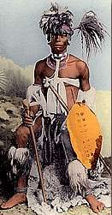
Africa Before Imperialism
Divided into 100’s of ethnic & linguistic groups
Mixture of large empires & small independent villages
Most practiced traditional beliefs
Others practiced Islam & Christianity

Slide 4
European Expansion
Europe became very aggressive in expanding land outside of its current borders
Focus was primarily expansion in Africa
Before 1800’s Imperialism was known as the dark continent
The world only new of the coast and creating trading ports
European countries were becoming bankrupt of from fighting with each other
Post Industrial Revolution needed natural resources to boost economies
Further places to settle, grow, and invest in

Slide 5
Political
Bases for trade & military ships
Power & security of global empire
Spirit of nationalism

Slide 6
Resistance
African tribes did not surrender voluntarily but European Nations had:
Superior technology
Superior armies and navies
More structured and powerful government
Strong economies comparatively
So nearly impossible to stop

Slide 7
Social
Missionaries Spread Christianity
Share western civilization
Belief than western ways are best
Social Darwinism

Slide 8
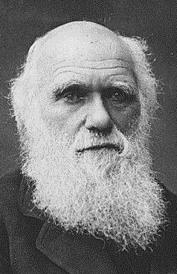
Social Darwinism
Applied Darwin’s theory of Survival of the fittest to competition between nations
Natural for stronger nations to dominate weaker ones

Slide 9
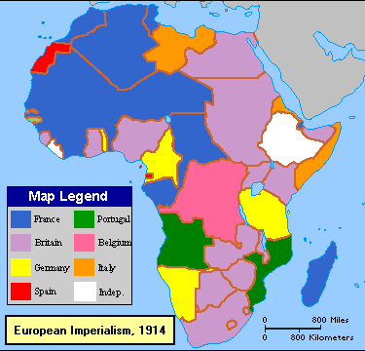

Slide 10
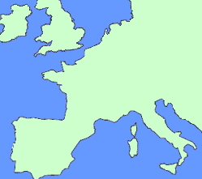
Effects of Imperialism
Positive Results | Negative Results
1. Unified national states created | 1. Encouraged tribal wars by creating artificial borders
2. Improved medical care, sanitation, and nutrition | 2. Created population explosion → famine
3. Increased agricultural production | 3. Produced cash crops needed by Europeans, and not food for Africans
4. Improved transportation and communication facilities | 4. Exploited natural resources: minerals, lumber, rubber, human rights.
5. Expanded educational opportunities | 5. Downgraded traditional African culture → westernization

Slide 11
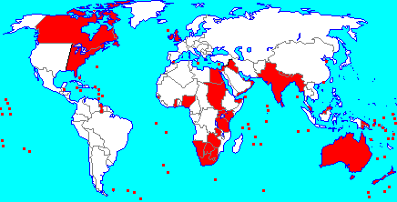
British Empire
The sun never set on the British Empire

