Slide 1
Big Business

Slide 2
Industry Leaders
The increase infrastructure and inventions allowed many to profit off expansion
With all of these new inventions and strategies who is going to benefit?

Slide 3
Business Strategy
Goal- Keep your $
To make things faster and cheaper
Goal- Know where the $ is going
Detailed accounting practices
Goal- To get the best associates and cheapest workforce
Offer stock to top assistance-incentive cutting cost

Slide 4
Business Strategy
Without any business regulation Titans of Industry could find any way they could to make more money

Slide 5
Business Terms
Capitalism-Economic system which country’s trade and have private owners, not the government
Monopoly- Exclusive possession or control of one commodity or service. No competition
“Robber Baron”- Wealthy Businessman that exploits natural resources, corrupt legislators, and use any means necessary to get their rich.

Slide 6
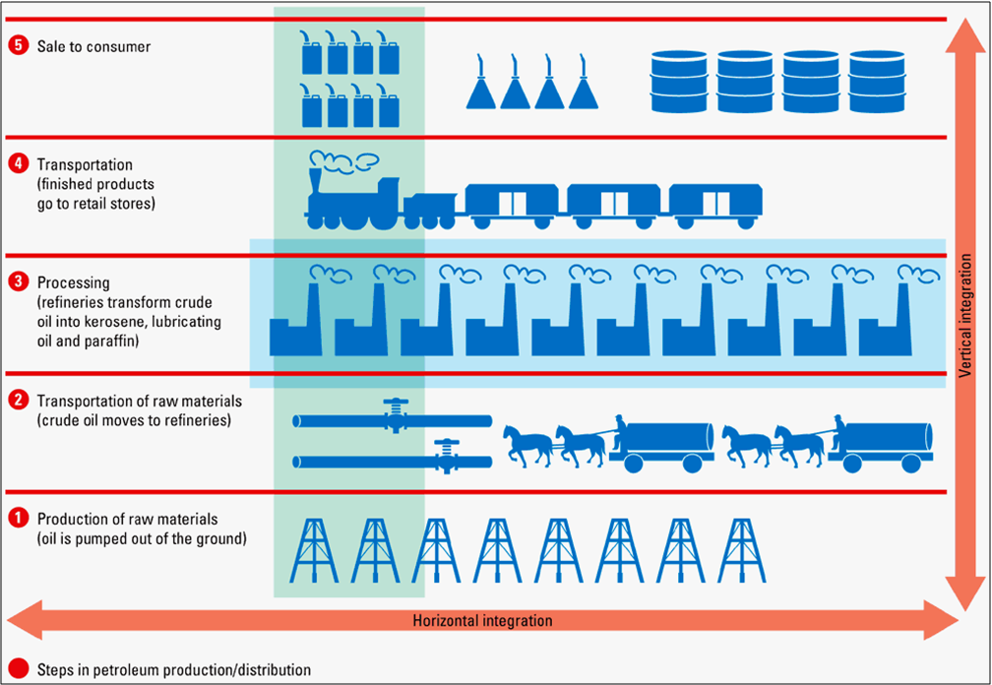
Monopolies

Slide 7
Titans of Industry
Andrew Carnegie-Steel
John D. Rockefeller- Oil
Cornelius Vanderbilt-Railroad
J.P. Morgan-Banking and Investment
http://www.shmoop.com/great-inventions
Titans of Industry
Project

Slide 8
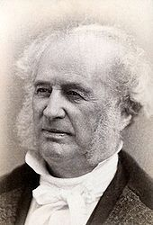
Cornelius Vanderbilt
Key Events
Philanthropy

Slide 9
Cornelius Vanderbilt
Corruption
So What/Legacy

Slide 10
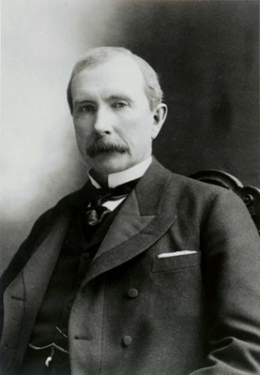
John D. Rockefeller
Key Events
Philanthropy

Slide 11
John D. Rockefeller
Corruption
So What/Legacy

Slide 12
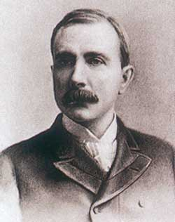
John D. Rockefeller
Started Standard Oil
Refined oil for other uses
Mainly kerosene for lamps
Became the world’s largest corporation
Established the first “trust”
He was the richest man in the world - over $318 billion today!
Gave away nearly 500 Million dollars to start University of Chicago and his foundation. Rockefeller Center

Slide 13
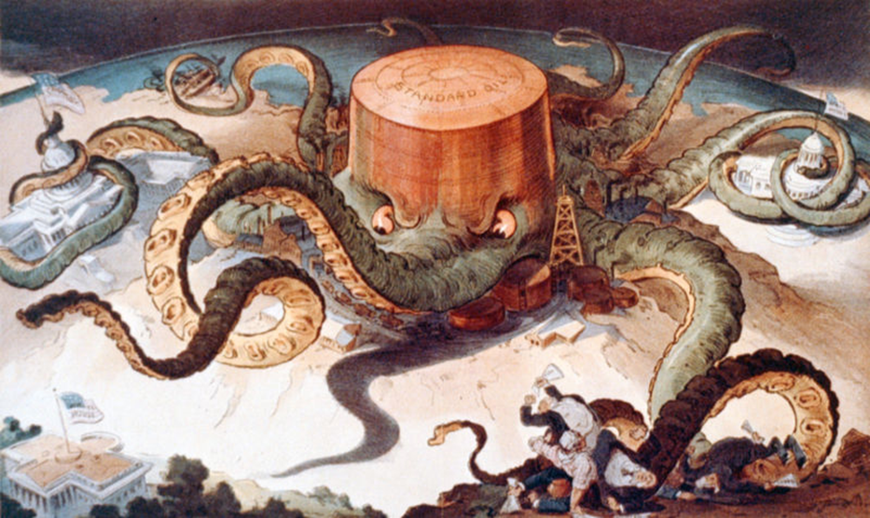

Slide 14
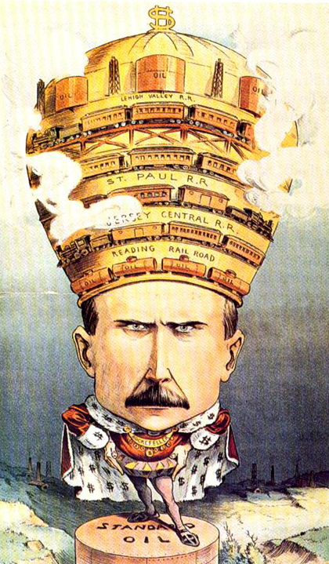

Slide 15
John D. Rockefeller
Some say he was an innovative “captain of industry”
Others say he was a greedy, corrupt “robber baron”

Slide 16
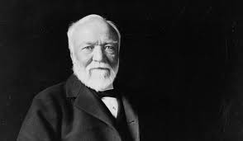
Andrew Carnegie
Key Events
Philanthropy

Slide 17
Andrew Carnegie
Corruption
So What/Legacy

Slide 18
Andrew Carnegie
Scottish Immigrant- parents had nothing when they moved here when he was a young child
Worked his way up- true “Rags to Riches” story (Messenger, telegraph operator, railroad division head, then started investing)
Built Carnegie Steel Corporation
Sold to JP Morgan in 1901 for $300 million

Slide 19
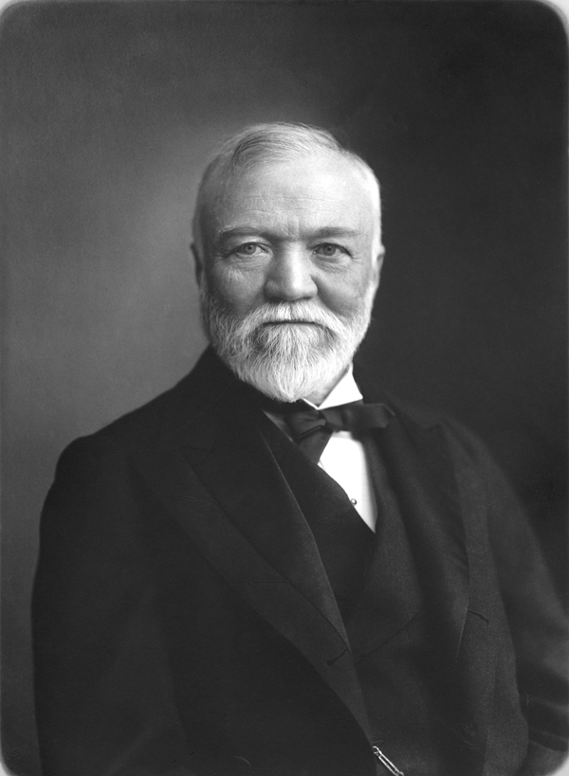
Andrew Carnegie 1835-1919
Different yet similar approach than Morgan and Rockefeller
Not as ruthless
More Charitable
Humble Beginnings
More difficult to name a “Robber
Baron” or “Titan of Industry”
Donated nearly 325 million dollars- Carnegie Hall

Slide 20
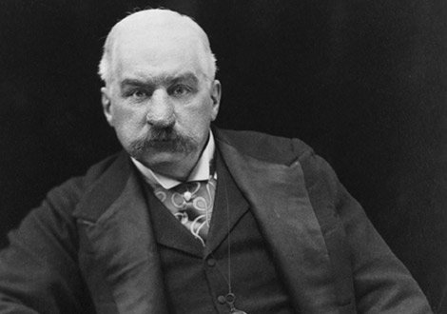
J.P. Morgan
Key Events
Philanthropy

Slide 21
J. P. Morgan
Corruption
So What/Legacy

Slide 22
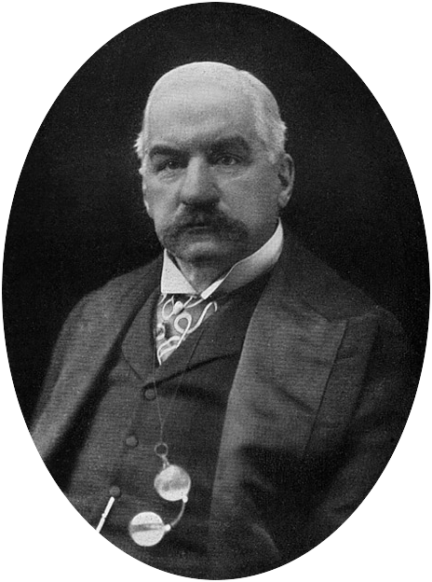
JP Morgan
An incredibly wealthy and powerful banker and investor
Known best for banking and financing megacorporations
General Electric
US Steel

Slide 23
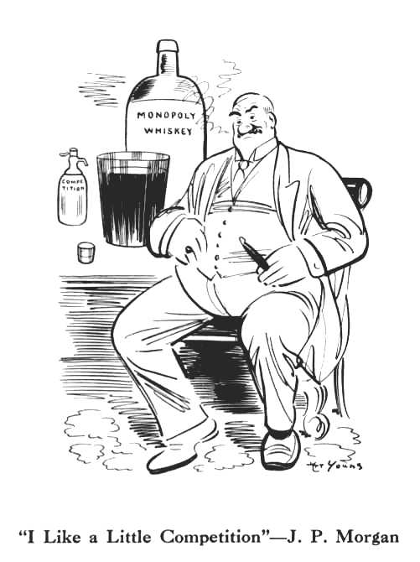
“Morganization”
JP Morgan’s strategy of buying up small businesses in the same industry and combining them into one massive company
Only possible because of his incredible wealth!!!
He was in total control!
Often times fired many of the workers
increased the price of goods

Slide 24
Who Will Light America?
Jp Morgan invested in Thomas Edison- DC current
The 1893 Chicago World’s fair needed light
But, Nikola Tesla invented AC current- ultimately wins contract of World’s Fair
Short Range- Worth millions
Long Range of showing electricity to the world-Billions

