Slide 1
Mobilizing War and the Economy

Slide 2
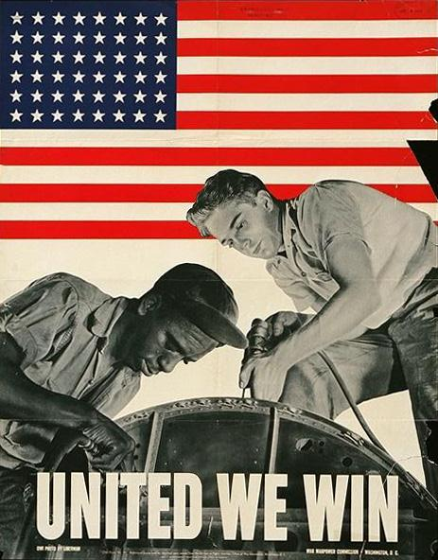
Mobilizing for Victory
· During World War II, 10 million men were drafted, and another 6 million men and women enlisted.
After Pearl Harbor many were eager to serve for their country!
And still needed more!
Captain America?

Slide 3
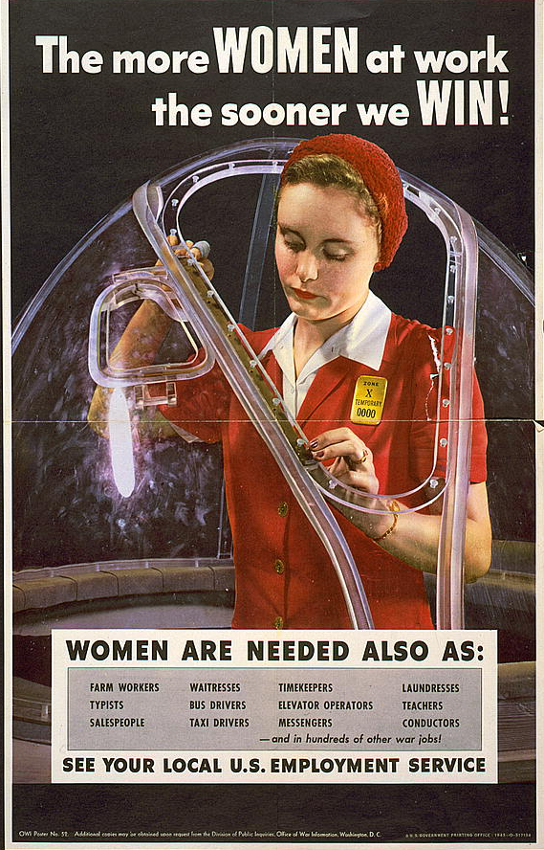
Women in the War Effort
Took over many jobs for servicemen, most notably in heavy industry
Some joined the military
Altered family life, brought several drawbacks
A poster urging women to take manufacturing jobs to help the war effort
Notes:
With millions of American men either enlisting in the armed forces or drafted, women had to take over many jobs usually performed by men, such as working in heavy industry, manufacturing tools of war including tanks, planes, and other materiel. The image of “Rosie the Riveter” became commonplace as women soon became the backbone of American industry during the war years.
Other women sought a more active role in defense by joining specially created women’s units in the armed forces. Many joined the WACs, WAVEs, SPARs, and other related units, filling many noncombat positions both stateside and overseas. Women also served as drivers, clerks, communications officers, pilots, and nurses. Thirty nurses were killed in action during World War II.
However, while many women became the family breadwinner and proved that they could work as hard as their male counterparts, wartime employment had substantial drawbacks. The divorce rate increased substantially, as did juvenile delinquency among females. The incidence of alcoholism among women also grew. Many women had to uproot themselves and their families to relocate to communities that provided more defense-industry opportunities. A new generation of “latchkey kids” frequently found itself without parental guidance or supervision, perhaps with fathers in the military and mothers working a shift at a defense plant.
3

Slide 4
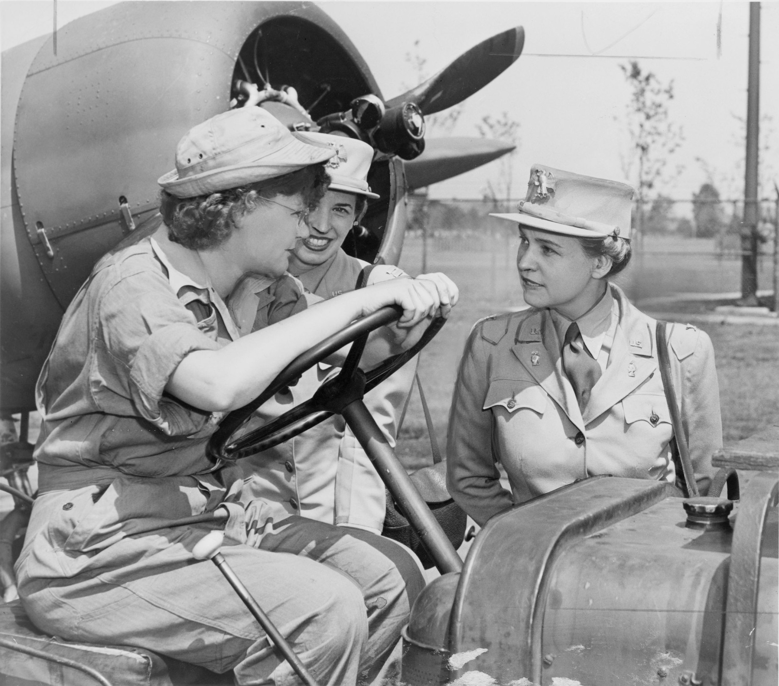
The Women’s Army Corps
Marshall noted British success in using women for noncombat duties
Congress created Women’s Auxiliary Army Corps in 1942
WAAC later renamed “Women’s Army Corps”
WAC Director Col. Oveta Culp Hobby (right) confers with WAC members at Mitchell Field, NY
Notes:
U.S. military leaders saw in the early days of the war that the female population could provide significant military service as well. Impressed with the British army’s incorporation of women in military service, Army Chief of Staff George C. Marshall became a main proponent of a women’s unit for the U.S. Army. With his backing, and at the urging of other women leaders including First Lady Eleanor Roosevelt, Congress created the Women’s Auxiliary Army Corps (WAAC) in May 1942. Congress upgraded the WAAC to full military status within a year, renaming it the “Women’s Army Corps” (WAC).
WACs (as corps members were informally known) contributed to the war effort by performing more than 200 noncombat jobs, including operating switchboards, driving staff cars, and sorting mail. The military stationed WACs at more than 400 mainland military bases as well as in both the European and Pacific theaters. By the end of the European war, the WACs had more than 100,000 members, including more than 6000 commissioned officers.
The army named as director Oveta Culp Hobby, wife of former Texas Governor William Hobby and head of the War Department’s Women’s Interest Section. After the war, she became the first secretary of the newly created Department of Health, Education, and Welfare (later, the Department of Health and Human Services).
4

Slide 5
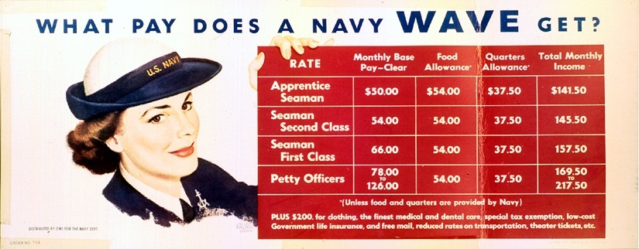
WAVEs
“Women Accepted for Voluntary Emergency Service”
Navy program similar to WACs
Did not serve overseas
Nurses, clerical work, communications jobs
A WAVES recruitment poster explaining the pay scale for members
Notes:
With the WAAC established by summer 1942, the navy followed suit with a similar program, called “Women Accepted for Voluntary Emergency Service” (WAVES). Although an official part of the navy, the program’s name indicated its temporary nature; after the war ended, members would be discharged.
The navy stationed WAVEs (as individuals were called) only in the continental U.S. or in U.S. possessions such as Hawaii. They did not serve in any combat zones. Most WAVEs worked as nurses, in communications jobs and clerical positions, and as storekeepers. The U.S. Coast Guard established a similar program, called “SPAR,” after the initials of that branch’s motto, “Semper Paratus” (“Always Ready”).
In 1948, Congress disbanded the WAVEs by passing the Women’s Armed Services Integration Act, which gave women permanent status in the armed forces. However, most female recruits were known as WAVEs for much of the 20th century.
5

Slide 6
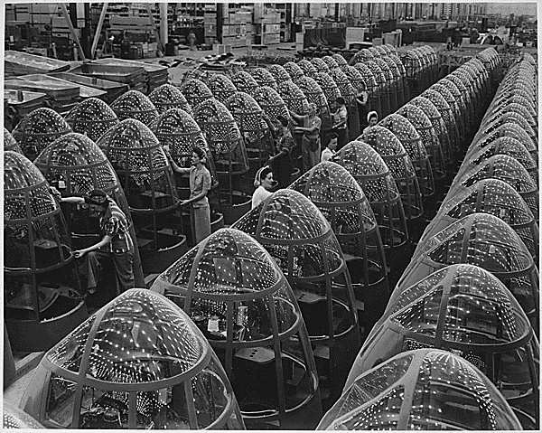
Women in the Workforce
Women were encouraged to work in defense plants
Others grew Victory Gardens and helped with recycling for the war effort
Generally earned less than male workers
Factory workers polish Plexiglas nose cones for A-20 attack bombers
Notes:
Although some women joined the military during the war, most found they could assist the war effort by working in the private sector. By war’s end, nearly 18 million women worked outside the home—one-and-a-half times the number that had performed similar labor in 1939.
The shortage of male workers led employers to suggest that women’s work as homemakers had adequately prepared them for work in industry. The majority of women working in defense plants earned much less than their male counterparts, though many used to working as homemakers without pay accepted lower salaries without question.
Many married women with the responsibility of raising children as well as managing the home, stayed housewives. However, they contributed to the war effort by growing Victory Gardens (which fed the family and freed food resources for troops’ consumption) and working in recycling drives, as well as buying war bonds.
6

Slide 7
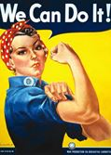
Rosie the Riveter
Along with helping the armed services many women took to factories and industry jobs that were needed
Symbolized the millions of women that worked in factories producing tanks, ships, and planes, other war goods.
A woman doing a man’s job!
Rosie
http://www.youtube.com/watch?v=55NCElsbjeQ

Slide 8
Minorities fighting in WWII
Many minorities served in WWII, in particular African Americans.
Although while in the service minorities were segregated together amongst their own group
Often were rarely recognized for achievements

Slide 9
Minorities in the Workplace
Was still a demand for more workers, but often African Americans only received the low wage paying jobs, even if experienced or refuse to hire them

Slide 10
African Americans and the War
The irony of fighting a racist regime in Europe while experiencing racism at home
Blacks found limited employment in defense plants
Race riots broke out in many cities
African Americans looked for equality in the workplace and in the military
Notes:
African Americans, who had been experiencing discrimination long before the war, found that conditions did not change substantially for them during the war years. Many struggled with the grim irony of helping to defeat a racist enemy in Europe while facing the effects of racism and discrimination at home. In addition, the U.S. military itself had segregated units.
Many African American workers could not find good jobs at defense plants because of their color. Those who did secure employment frequently received lower salaries than whites. Blacks who migrated to cities in search of defense jobs found housing scarce. Northern blacks unaccustomed to Jim Crow laws had difficulty adjusting to the culture of Southern industrial cities.
This migration of African Americans resulted in friction between whites and blacks which frequently boiled over into violence. In the summer of 1943, race riots erupted in 47 cities. In Detroit, riots claimed the lives of 25 blacks and nine whites, with hundreds of persons injured.
However, African Americans also looked for ways that they could ensure equality both on the battlefield as well as at home.
10

Slide 11
The “Double V” Campaign
Created in 1942 by the Pittsburgh Courier, a leading black newspaper
Called for “victory over our enemies at home and victory over our enemies on the battlefields abroad”
The campaign’s logo
Notes:
One of the earliest organized protests against the discrimination of African Americans came in the form of the “Double V” campaign, led by the Pittsburgh Courier, one of the leading black newspapers of the era. The campaign called for two victories: “victory over our enemies at home and victory over our enemies on the battlefields abroad.” The Courier asserted that the time had come to “persuade, embarrass, compel, and shame our government and our nation…into a more enlightened attitude.” Courier reader James G. Thompson of Wichita, Kansas, had proposed the idea in a letter to the editor, while staff artist Wilbert T. Holloway designed the “Double V” logo. Soon, “Double V” clubs sprang up nationwide, and other newspapers backed the campaign editorially.
After the war, the Courier continued with a “Single V” campaign: while the war had ended with victory over the Axis, victory over those who discriminated against African Americans in the U.S. had yet be realized.
11

Slide 12
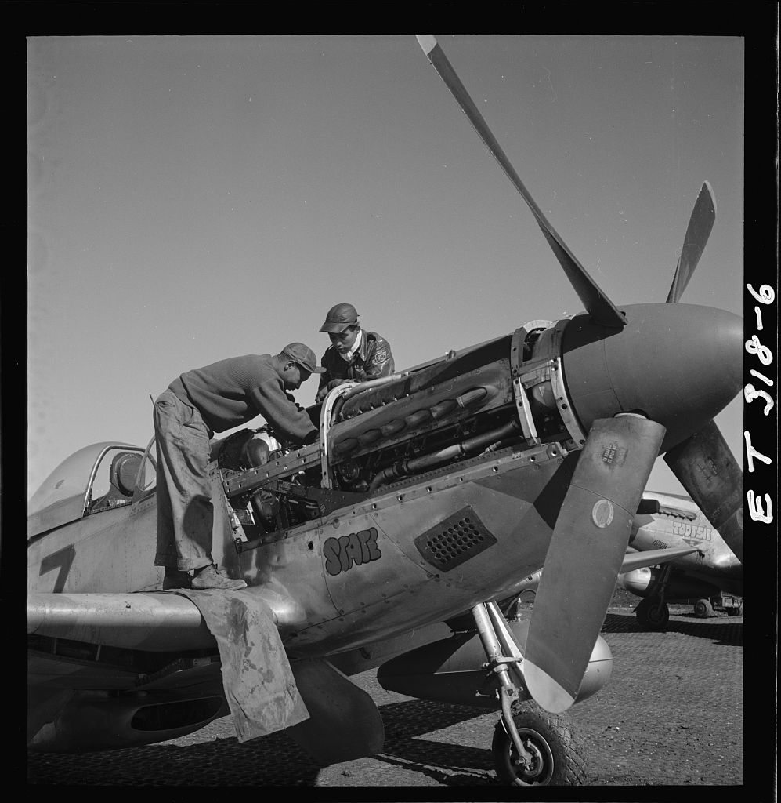
The Tuskegee Airmen
All-black combat unit formed in 1941
99th Fighter Squadron formed in AL
Commanded by Davis
Escorted bombers over central Europe
Proved superior or equal to white pilots
Airmen Marcellus G. Smith and Roscoe C. Brown in Italy, 1945
Notes:
Just as the 442nd Regimental Combat Team proved Japanese Americans to be as skilled in combat as white troops, the Tuskegee Airmen demonstrated the abilities of African Americans. The Army Air Corps formed an all-black unit in 1941, under congressional pressure. The War Department tried to thwart the plan by requiring that recruits either had flight experience or a higher education. A large number of African Americans nonetheless met the requirements and enlisted in the program. The Army Air Force established the 99th Fighter Squadron at Alabama’s Tuskegee Institute, selecting Captain Benjamin O. Davis, Jr. (one of the few black West Point graduates) to command the squadron.
A white officer commented in a Time magazine article that the black pilots were inferior to white pilots. Following a congressional committee hearing, a subsequent evaluation of all pilots in the Mediterranean Theater showed the Tuskegee pilots to be equal to or better than other P-40 pilots.
Tuskegee Airmen who escorted bombers in missions over central Europe shot down more than 100 enemy aircraft. Many claimed for years after the war that the Airmen did not lose a single plane they escorted, though later evidence proved that some bombers were lost. However, many point to the real achievement of the Tuskegee Airman as proving that African Americans could perform just as well as white pilots.
12

Slide 13
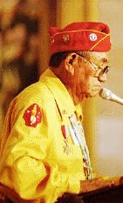
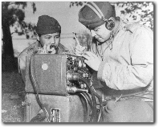
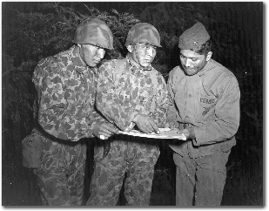
Native Americans in WWII
1 out of 3 Native Americans served in WWII
Many of them became part of the group, the Navajo Code-Talkers
The Code-Talkers used their own languages to communicate messages across enemy lines
Even though these messages were often intercepted, no one was ever able to interpret them

Slide 14
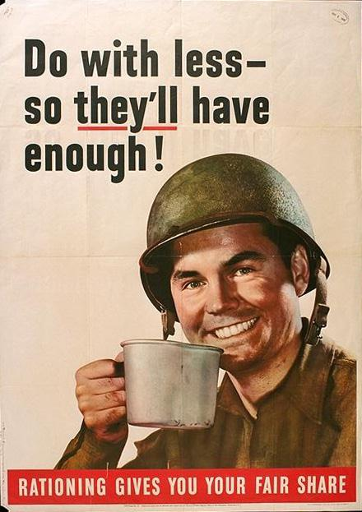
Production
·
Like in WWI the government controlled the economy as it did during World War I.
- the government set prices and rationed scarce goods
- the War Production Board helped factories to produce war goods
Socialism?... Maybe?

Slide 15
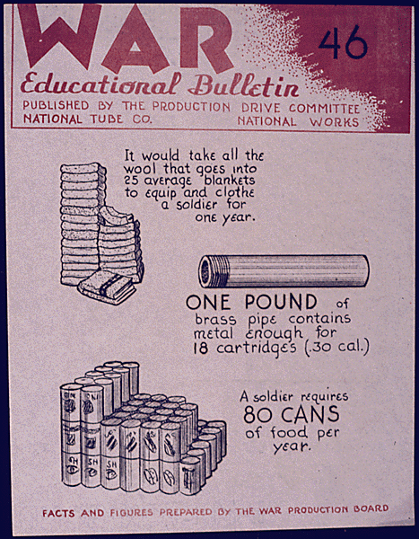
War Production Board
Ensured that the military had the resources it needed
Directed industrial output
Prohibited nonessential business activities
Allocated raw materiel
Organized scrap drives
A “War Educational Bulletin” produced by the War Production Board
Notes:
In order to coordinate the “production miracle” needed to win the war, the Roosevelt Administration created several boards and agencies which significantly altered American business and the economy during the war years. The War Production Board ensured that the military received the resources it needed to fight the war. Since the government had to acquire massive amounts of materiel to fight the Axis, it also needed to direct a large portion of industrial output to military purposes. Headed by Sears, Roebuck and Co. Chairman Donald Nelson, the WPB suspended nonessential business activities, such as the manufacture of civilian automobiles, for the duration of the war. It assigned priorities to scarce materiel and allocated raw materiel to key industries. It also organized and encouraged scrap drives to recycle waste materiel into needed goods.
15

Slide 16
Production
War production is booming ex. Tanks, Planes, Ships, Jeep
Key factor in getting out of the Great Depression
Government makes sure no strikes occur during war production.
Food goods had shortages
Conservation of all goods that soldiers may need
Many items, such as fuel and sugar, were rationed during the war.
- No new cars were produced after 1942.

Slide 17
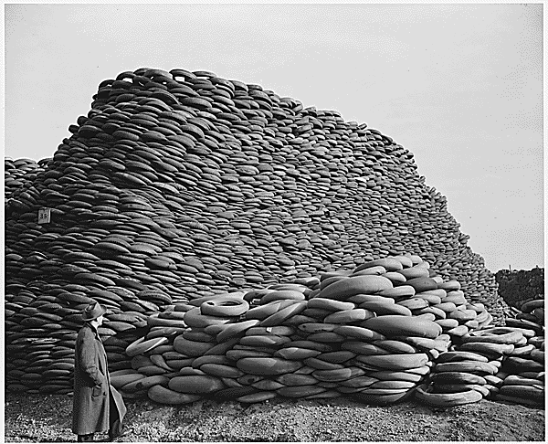
Scrap Drives
Organized by the WPB
Encouraged collection of waste and scrap goods for war use
Materiel included iron, aluminum, paper
Waste cooking fats for making glycerin
Results of a scrap rubber drive
Notes:
In addition to the War Production Board’s attempt to allocate scarce materiel to industry, it also encouraged civilian populations to recycle waste and scrap materiel for reuse as war resources. Women and children collected and turned in tons of scrap metal, aluminum, newspaper, and waste cooking fats. The U.S. government especially urged children to participate, calling them “Uncle Sam’s Scrappers,” or “Tin Can Colonels.”
The WPB estimated that 30 million schoolchildren across the nation collected 15 million tons of scrap metals. It declared that this amount of scrap metal could build 425 Liberty ships. The WPB especially prized waste cooking fats because they were used to make glycerin, an important ingredient in the manufacture of gunpowder. Making one pound of gunpowder required three pounds of glycerin; therefore, firing a 12-inch shell from a navy cannon took nearly 350 pounds of glycerin.
17

Slide 18
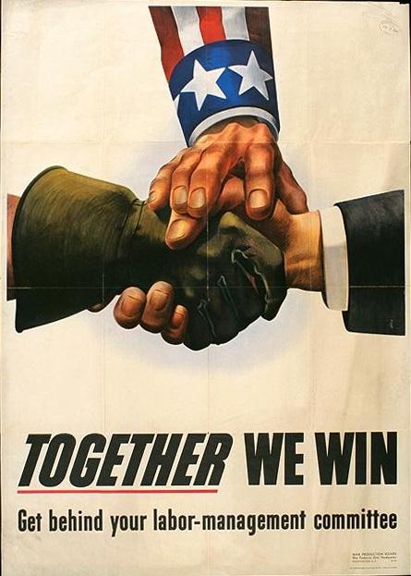
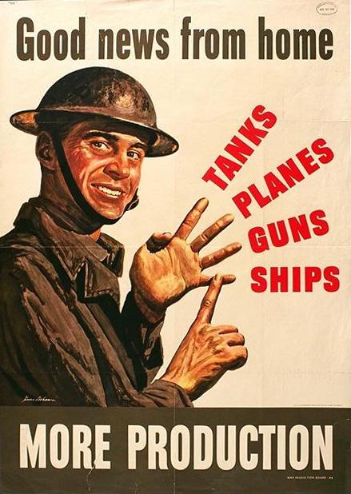

Slide 19
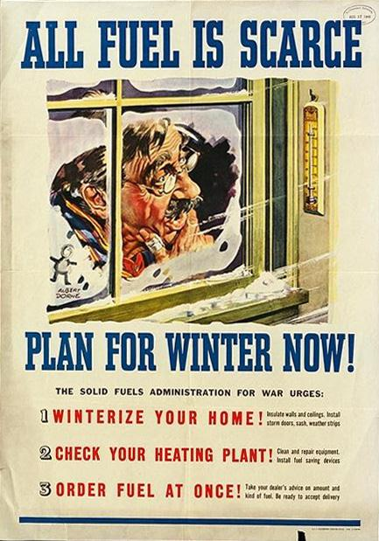
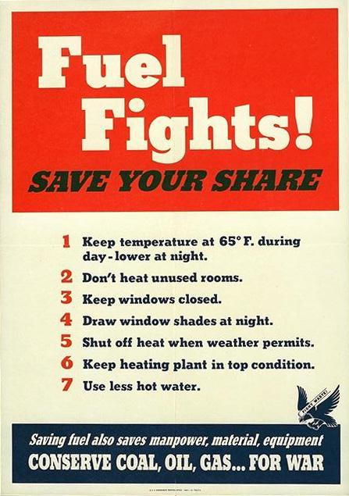
Conservation!
Saving fuel may save lives!

Slide 20
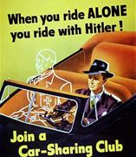

Slide 21
Financing the War
U.S. spent more than $321 billion (more than $3 trillion today)
National debt increased dramatically
More Americans required to pay income taxes
War-bond sales raised needed revenue
Notes:
World War II demanded significant changes to the nation’s economic system. The U.S. spent more than $321 billion (more than $3 trillion in today’s dollars) fighting the Axis powers. This amounted to more than twice what the federal government had spent in its entire existence. As a result, the national debt skyrocketed as well, to nearly $260 billion by the war’s end.
One way the government helped pay its expenses was with a substantially increased income tax rate. By the end of the war, about 40 million Americans filed tax returns—more than ten times the number in 1941. For the first time, the government required employers to withhold a certain percentage of their employees’ paychecks, depending on their salary and how many dependents an employee claimed. That way, the employee would have withheld enough tax to avoid having to pay a much larger sum at the end of the year, or to receive a refund from the government.
In addition, the government raised $185 billion through the sale of war bonds to private individuals, banks, and industry.
21

Slide 22
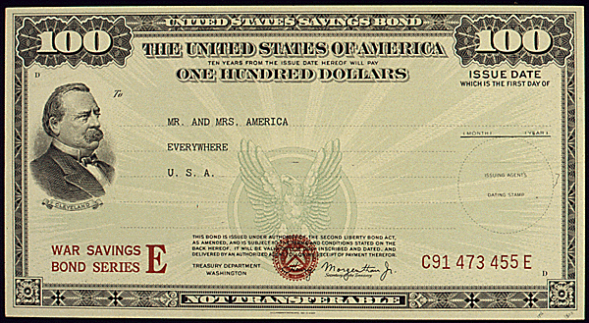
War Bonds
Used to help finance the war
More than $185 billion sold
Bought by businesses, banks, and civilians
Celebrities helped with bond drives
High interest rates
An example of a $100 war bond
Notes:
While the government sought to pay for the war with higher tax rates and deficit spending, assistance—to the tune of $185 billion—came also from the purchase of war bonds, a type of savings bond. Many corporations, banks, and insurance companies bought the bonds, but civilians did as well, including children, who could purchase “war stamps” they could later convert into bonds. Many celebrities and sports heroes participated in bond drives to raise demand.
War bonds yielded a substantial benefit to those purchasing them. Bonds could be used as a savings plan for expenditures such as buying a new home or providing for children’s education. Interest rates for bonds were comparable to or higher than rates for most other savings plans in the 1940s.
22

Slide 23
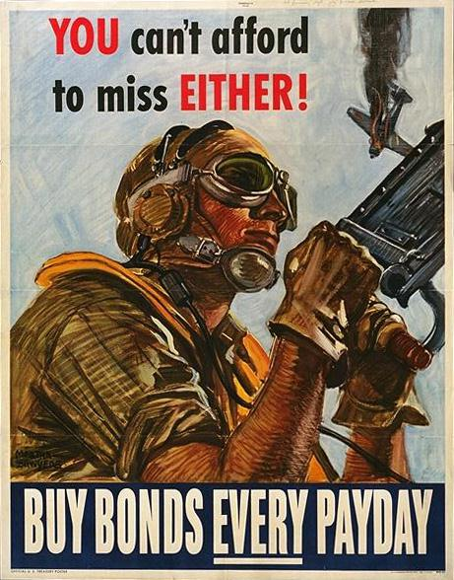
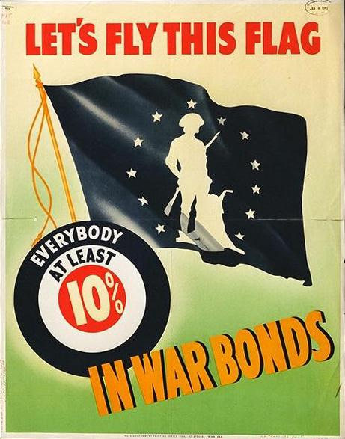

Slide 24
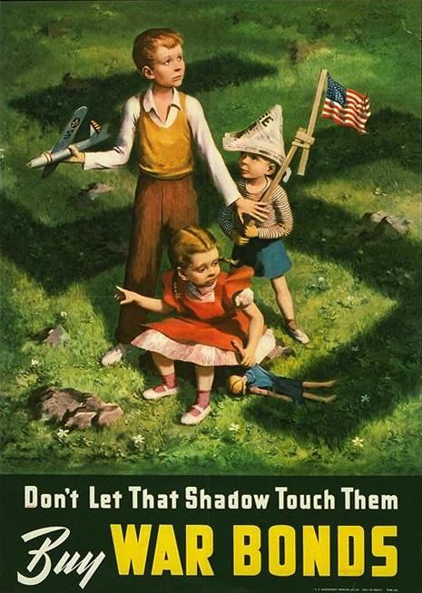
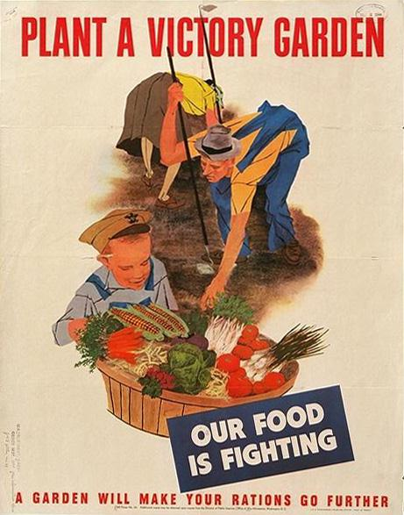

Slide 25
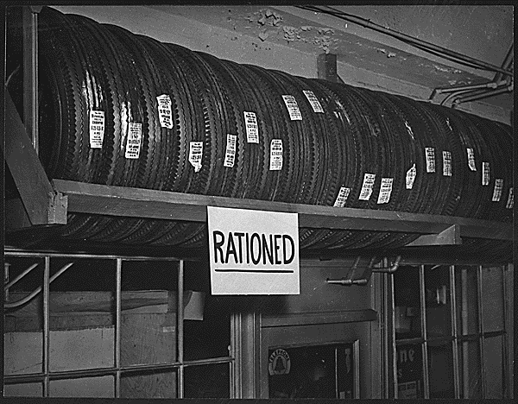
Office of Price Administration
Designed to limit wartime inflation
Established “ceiling prices” for many goods
Rationed scarce goods and many consumer staples
Rationing stopped at end of war
Dissolved in 1947
Notes:
The possibility of inflation greatly concerned the federal government. As goods became harder for the civilian population to purchase, their prices would skyrocket. Worried about the inflation’s effect on the U.S. economy, the Roosevelt Administration created the Office of Price Administration in early 1942. The OPA established “ceiling prices” for many commodities, most fixed at their March 1942 levels, above which they could not rise. The OPA froze nearly 90 percent of the nation’s retail prices during the war.
In addition, the OPA rationed what the government considered “scarce” goods. Several staples of American life, such as gasoline, automobile tires, sugar, coffee, meats, and processed foods were tightly rationed; some supplies were nearly nonexistent. Millions of Americans found themselves either substituting for scarce goods, doing without, or trying to purchase goods on the black market. With the end of the war, the OPA quickly abandoned rationing; the agency ceased to exist in 1947.
25

Slide 26
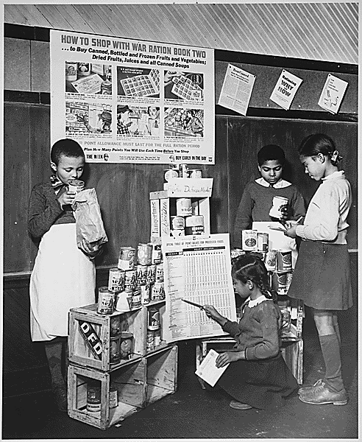
Rationing
Way to allocate scarce goods
Included meat, butter, sugar, coffee, shoes
Stamps and points system
Gasoline rationing particularly complex
Black market emerged
Children learning to tally points and ration stamps
Notes:
The government realized it needed a system for allocating goods so that both military and civilian populations could get what they needed. The response to this problem was rationing, a way to limit the purchase of scarce goods.
Some of the more contested-for rationed goods included meat, butter, sugar, coffee, canned and frozen foods, and shoes. To effectively calculate what goods the consumer might buy, the OPA devised a complicated system of stamps and points. A person without the right combination could not buy the good. Gasoline proved particularly difficult to ration. The OPA granted most motorists an “A” sticker for their car windshield, which guaranteed them four gallons of gas per week. “Essential” workers got “B” stickers entitling them to eight gallons per week. Those whose professions required them to drive (such as physicians, ministers, railroad workers, and mail carriers) received “C” stickers. “X” stickers went to government officials and public servants such as police, firefighters, and civil-defense workers. “T” stickers went to truck drivers who carried goods essential to the war effort; they could buy an unlimited supply of fuel.
Regardless of their level of patriotism, many Americans found doing without staples of daily life to be unappealing, and a robust black market soon developed to sell highly prized and highly priced goods. However, both civilian and military populations generally had the goods and materiel they needed during the war years.
26

Slide 27
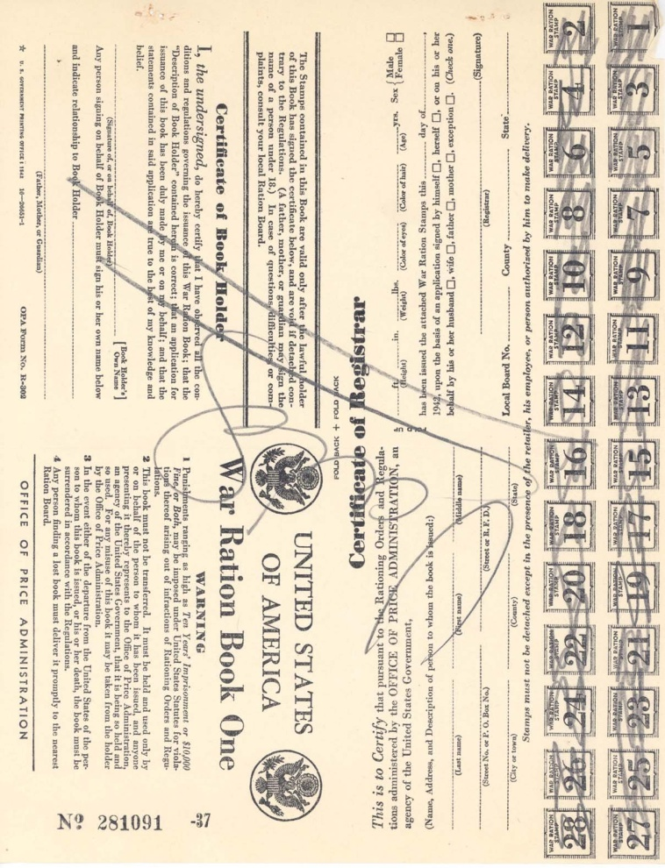
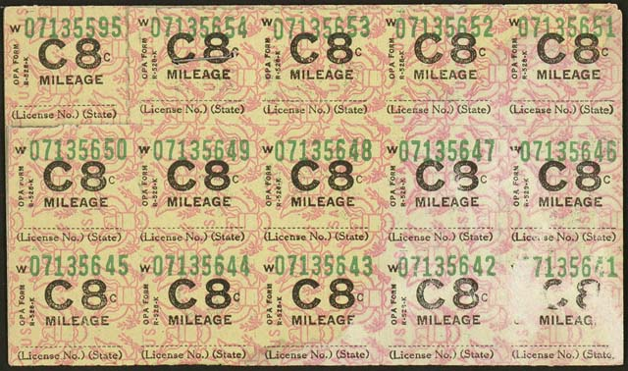
Rationing: Books and Stamps
Each family received ration books (left) and stamps (above) for determining its monthly allotment.
Notes:
The government devised a system of ration stamps and books, as well as a complex point system, to fairly determine what families and individuals could buy monthly. For example, goods such as meat, butter, fats, and cheese required red stamps; purchasing other goods, including fruits, vegetables, soup, and baby food involved blue stamps. The point system tended to frustrate many households, with some goods requiring a certain number of points, and others not needing any points. In addition to the multi-tiered system for rationing gasoline, drivers had to live with a 35 mph speed limit to conserve gas as well as tires.
Rationing ended along with the war, and all phases of it vanished by 1946.
27

Slide 28
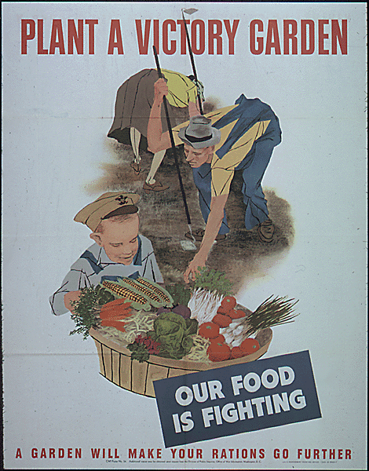
Victory Gardens
Government urged citizens to grow fruits and vegetables
Eased food shortages caused by rationing
Nearly 20 million started gardens
More than nine million tons of produces
A government poster promoting Victory Gardens
Notes:
Many Americans found that rationing made many food staples—particularly fruits and vegetables—difficult if not impossible to get. To alleviate the stress on the rationing system, the government encouraged many to plant “Victory Gardens,” in which citizens could grow their own fruits and vegetables. Nearly 20 million Americans took this advice and started their own gardens. National publications such as Life and The Saturday Evening Post promoted Victory Gardens as patriotic and gave housewives helpful hints about preserving and canning fruits and vegetables grown in the gardens. The number of pressure cookers (used in canning and cooking) sold in the U.S. increased 500 percent between 1942 and 1943. The federal government later estimated that Victory Gardens produced more than nine million tons of fruits and vegetables.
28

Slide 29
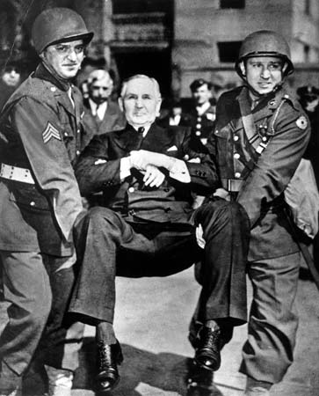
National War Labor Board
Arbitrated labor disputes during war
Board comprised of representatives from management, labor, and government
“No-strike pledge”
Some “wildcat” strikes still occurred
Guardsmen carry Sewell Avery, president of Montgomery Ward, from his office for failing to comply with NWLR rulings
Notes:
The Roosevelt Administration recognized that protracted disputes between management and labor could cripple the wartime economy and mobilization efforts. To settle these issues, FDR created the National War Labor Board in early 1942. The board comprised four labor union leaders, four corporate executives, and four public representatives. Early on, the board proved its usefulness when management and labor in communications and transportation industries agreed to a “no-strike pledge” for the duration of the war, agreeing that maintaining production outweighed striking for wages and benefits.
Union representatives to the board wanted a “closed shop,” in which all workers in a particular industry have to join the union. The NWLB refused that request, but did agree to what became known as the “maintenance of membership” clause, which forbade union members from quitting the union and required them to pay union dues, frequently through an automatic paycheck deduction. This approach helped to greatly increase labor union membership. While labor agreed to keep wage increases to a minimum, they gained significant benefits such as health insurance, vacation time, and pensions.
Regardless of the NWLB’s actions, some wildcat (i.e., unauthorized) strikes did occur. However, these generally caused little if any disruption to war production. The United Mine Workers under John L. Lewis struck three times in 1943, gaining some concessions, but losing a great deal of support as many states and Congress took steps to limit the power of unions.
29

Slide 30
The War’s Economic Impact
Nominal GDP more than doubled
Wages and salaries nearly tripled
Federal civilian employment more than tripled
Female employment up by a third
Labor union membership grew by over 50 percent
National debt ballooned by over 600 percent
Notes:
A number of changes to the U.S. economy occurred in the World War II era (1940–1945):
The nominal gross domestic product (the value of all goods and services produced inside a country in a year, not adjusted for inflation) of the U.S. increased substantially, from approximately $101 billion to about $223 billion. Wages and salaries rose from $45 billion to $120 billion.
In 1940, 14 million women worked outside the home; in 1945, the number was nearly 19 million, down slightly from 1944. Civilian employment by the federal government more than tripled, rising from slightly more than one million persons to nearly 3.5 million. Military employment mushroomed, as expected, from less than a million, to nearly 13 million.
Union membership also grew (due especially to the “maintenance of membership” clause enforced by the NWLB) from nine million to more than 14 million
Increases in GDP and employment led to a dramatic increase in the national debt, from about $41 billion to nearly $250 billion
30

