Slide 1
Corruption and Political Machines

Slide 2
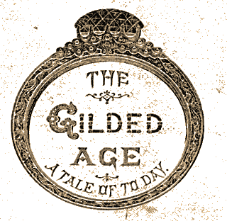
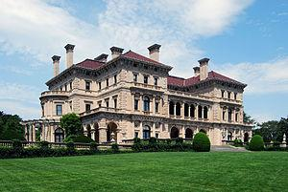
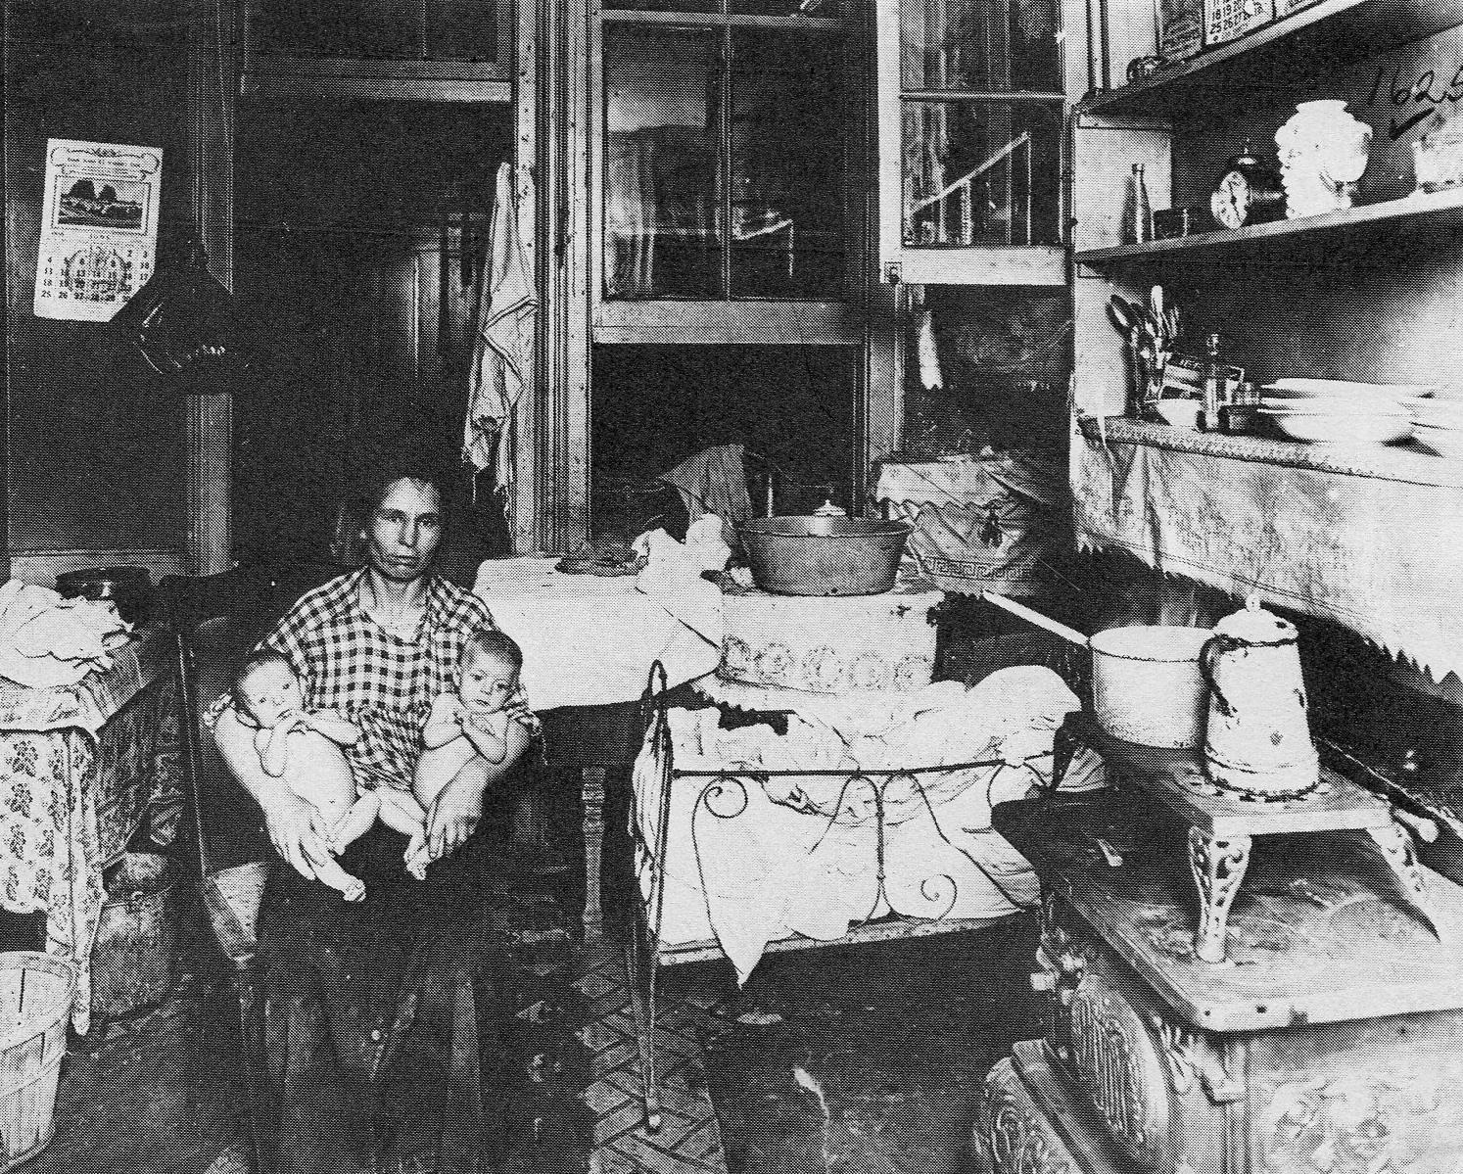
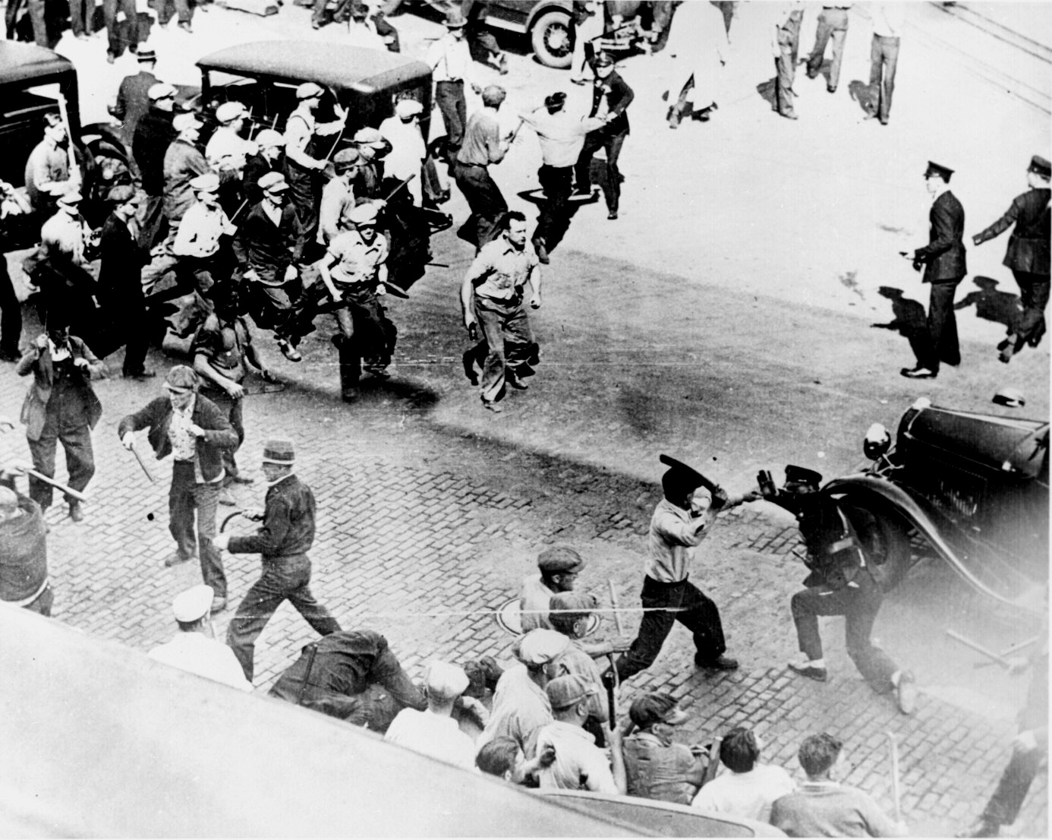
The Gilded Age
1870’s-1900
Name of a book written by Mark Twain and Charles Dudley Warner in The Gilded Age: A Tale of Today (1873), satirizing what they believed to be an era of serious social problems disguised by a thin gold gilding.

Slide 3
Corruption
With all of this wealth being built there are many flaws and problems
Income inequality is at its highest point ever
Top 1% own 88% of wealth
Rich are getting richer
Poor are not gaining at all
Poor work conditions

Slide 4
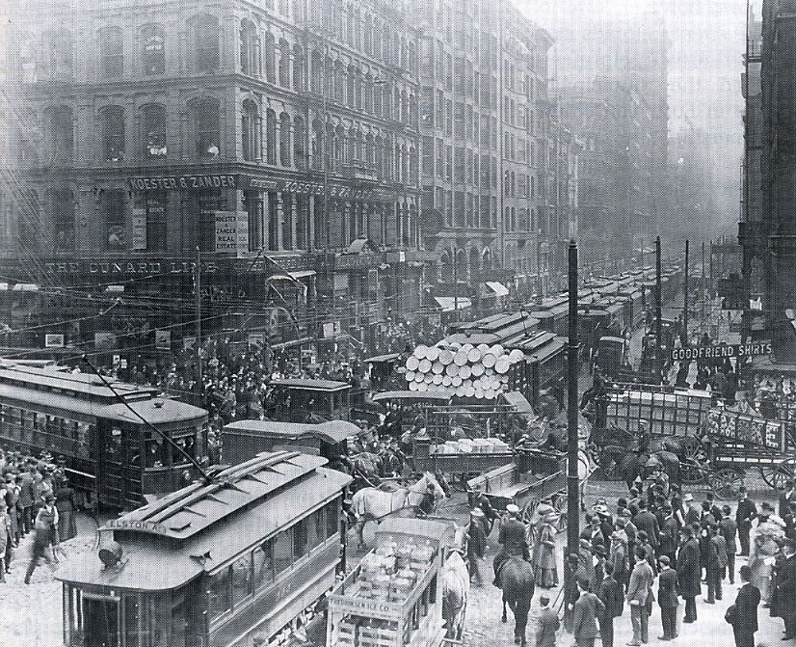
What started Political Machines/ Political Boss Rule ?
City governments were weak
Growing cities and industry led to significant problems
Sewers/ Sanitation
Electricity
Public transportation
Law enforcement
Political Machines stepped in to solve these problems

Slide 5
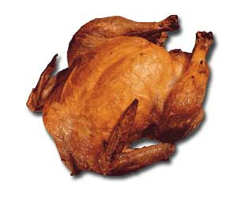
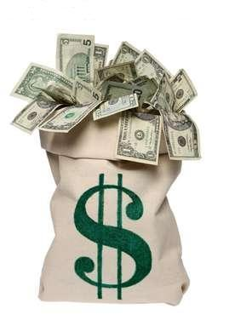
Why is it a “machine?”
Provide jobs, food, & money to poor/ immigrants in exchange for votes. Then you use your power to stay in charge and get rich!

Slide 6
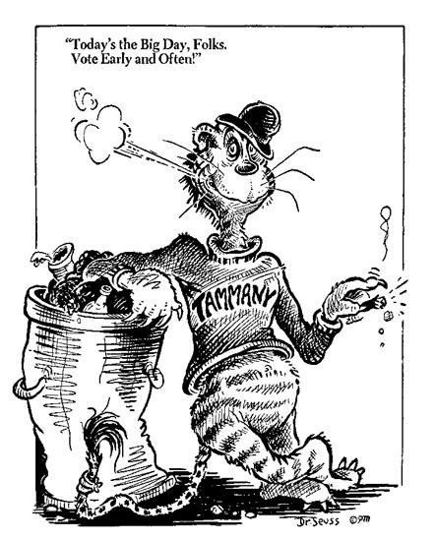
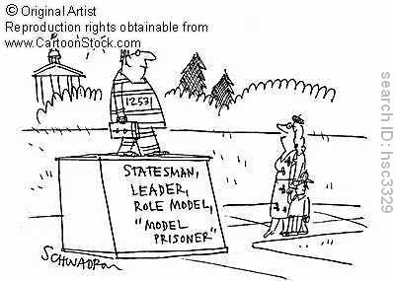
Graft: Making money from government projects
Patronage/Spoils System: Government jobs for supporters
Kickback: Money from city contractors for contracts, also overcharging

Slide 7
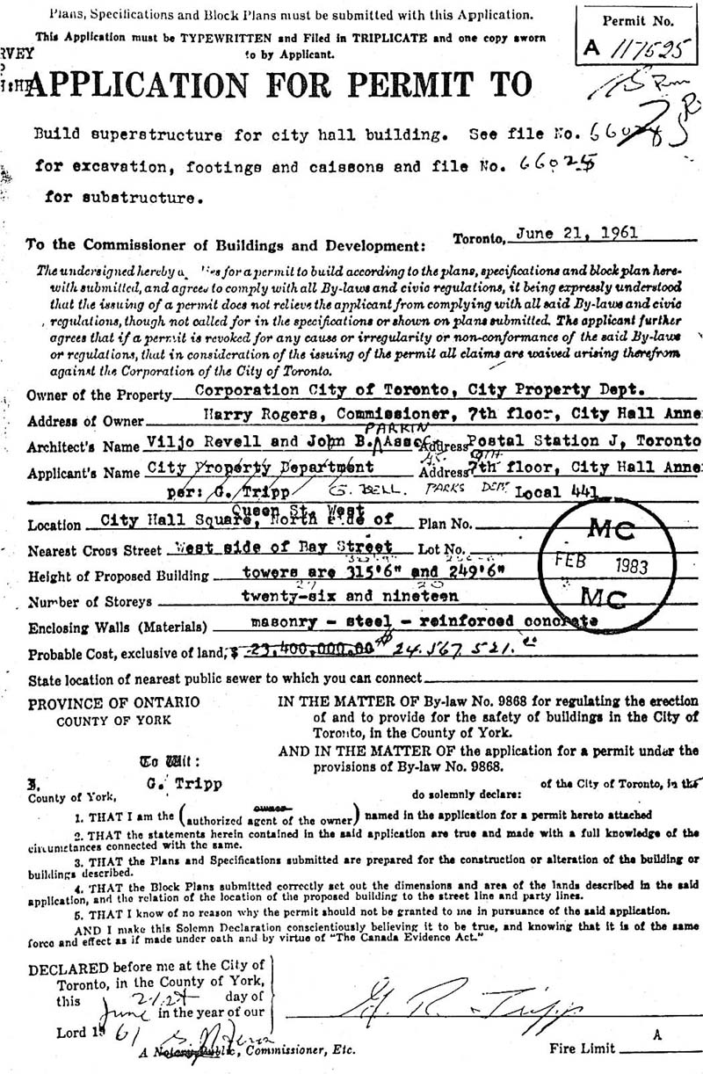
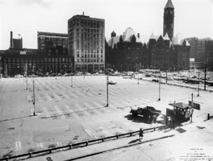
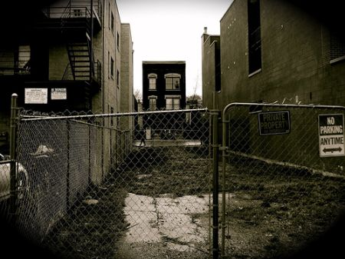
How did machines make money ?
Trading Favors
Selling permits
Selling land
Overcharging taxpayers
Protection/ payoffs
Bribery
Blackmail
Gambling /
prostitution/
Illegal activities

Slide 8
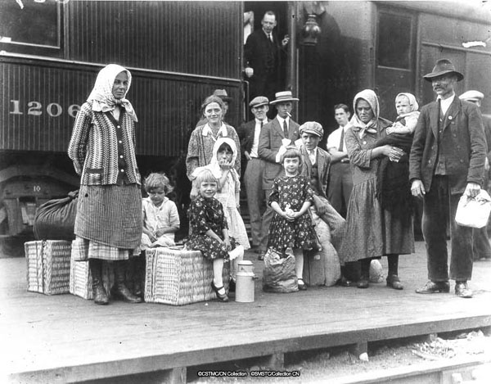
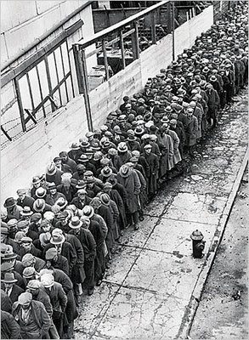
The Good,
Brought city services to citizens
Gave “representation” to those who never had it before (poor)
C. Acted as the early beginnings of welfare system (food, jobs).

Slide 9
The Bad,
They had a strangle-hold on the city
Corruption was widespread
Swindled money from the people
Turned democracy into a business
Election fraud

Slide 10
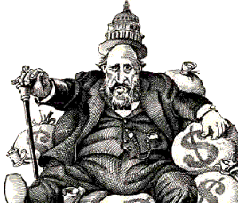
and The UGLY!
William “Boss” Tweed
Led Tammany Hall Machine in NY City
During 1860s-70s swindled New York for big $$$
-Court house
Tweed was convicted for stealing between $40 million and $200 million from New York City taxpayers through political corruption.
I’m not a crook…ah,
yes I am.

Slide 11
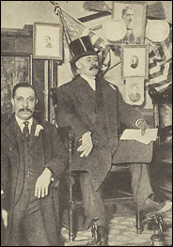
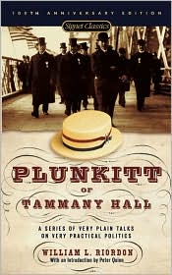
George Plunkitt – Tammany Hall
NY State Senator
Democracy= “the grocery store or dry goods, or the drug business.”
C. Believed in Honest Graft-make money from city without stealing it, similar to insider trading
D. Removed for graft and corrupt practices
https://gaggle.net/gaggleVideoProxy.do?op=view&v=98c201ed62782540e603fafe0e0a6271

Slide 12
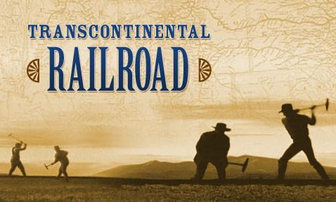
Federal Corruption
Credit Mobilier Scandal
Union Pacific overcharged the government for the transcontinental RR to the tune of $23 million
Gave the money to owners and members of Congress who had been given shares in the Credit Mobilier Company (part of Union Pacific Co)
Whiskey Ring 1875
Distillers bribed tax collectors and kept several million tax dollars from the government

Slide 13
Spoils System & Assassinations
Spoils System
Awarding government jobs to political supporters
Pres. Garfield Assassinated in 1881
Charles Guiteau didn’t receive a job through the spoils system so shot Garfield in Train Station
Chester A Arthur supported the Civil Service Act of 1883
Jobs based on merit not political connections

Slide 14
Can you buy a government?
Titans of Industry Did!
Grover Cleveland was president
American currency was falling apart
US gold stores had dropped to 30%
JP Morgan took advantage of the situation and “loaned” the US $62 million in exchange for bonds
When the economy recovered he sold the bonds for a higher price
Americans were infuriated by the power one man had and the role of big business in politics

Slide 15
Presidential election of 1896
Mckinley - friendly to the trusts - sided with big business
William Jennings Bryan - tough on big business wanted to break up trusts and monopolies - “people’s president”
the trio donated millions to make sure Mckinley was elected

Slide 16
Can you buy a president?
http://www.history.com/topics/john-pierpont-morgan/videos/presidential-election-of-1896
JP Morgan, JD Rockefeller and Andrew Carnegie united to donate huge amounts of money to William Mckinley

Slide 17
Can you buy a Bank?
A congressional committee that Investigated a
“money-trust”
The committee found that a small group of bankers dominated industry in:
Railroads
Utilities
Banking and finance

Slide 18
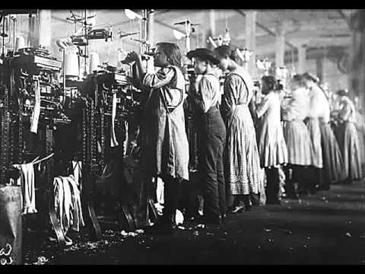
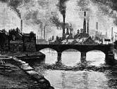
Through Their Eyes
Now after seeing the Titans of Industry making millions around
you:
What do you see?

Slide 19
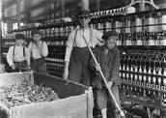
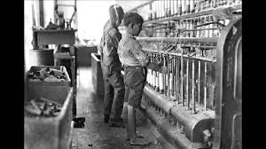
Through Their Eyes
Now after seeing the Titans of Industry making millions around
you:
What do you see?

Slide 20
Corruption
Working being taken advantage of
12-14 hour days
Child Labor
Low wages-$350 average/per year
No safety precautions
No way to start your own business in monopoly industries

Slide 21
Government to the Rescue
Investigation of a few large banks found they abused public interest to get total control of US finances
The Federal Reserve Act - Set up a Federal centralized bank to regulate finances in the US
With 12 regional banks to divide the workload
All other banks had to become members of the Federal Reserve System

Slide 22
Governing to the Rescue
Sherman Antitrust Act- Act wanted to restrain trusts or monopolies by declaring them illegal
Allowed the government to regulate interstate commerce
Tried to weak power
Removing these companies was hard because they would
dissolve and reform as corporations
Clayton Antitrust Act - Added to Sherman Antiturst Act
no more price discrimination and 1 person cannot
be on the board of 2 competing companies

Slide 23
Writing Assignment
You have to make a rap, song, or poem on 1 of 2 options
No swearing
Big Business/ Gilded Age OB’s- Original Ballers
Monopoly and trusts,
$
Profits
expensive things
philanthropy
Political Corruption/Hustle
Daily Struggle
Long work hours
Child Labor
No safety

