Slide 1
Dark Side of Slavery

Slide 2
Slavery
Modern slavery was first used in Americas in the Caribbean for Rice and Tobacco crops
Not all slaves throughout history were black
  Outsiders, debts, religion, ethnicity, language differences
Large chunks of population was not upper class

Slide 3
Universal Characteristics
Slave Society
  Slave labor at center of economy
    Americas and Caribbean
Society with slaves
  Slavery is important but not central
    Many historical and ancient used slavery

Slide 4
Types of Slavery
Domestic Slavery
  Could marry, possibly own land
    Similar of European Serf-attached to land
Captive Slavery
  Traded commodity, little to no rights

Slide 5
Important Distinctions
Africans did sell Africans-Simplistic
  Much more complicated than that
  We never say bunch of white people killing other whites
Many died before even stepping foot in the Americas
Many were from different tribes to minimize revolts
Rebellion was actually quite common
  Few were successful

Slide 6
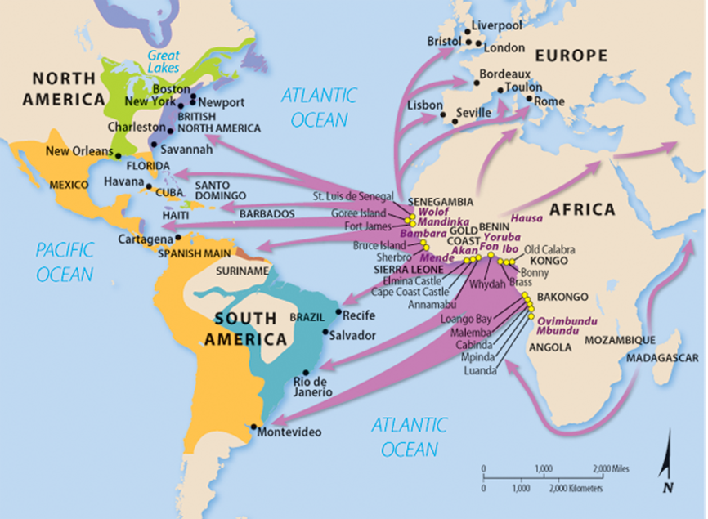
Evidence

Slide 7
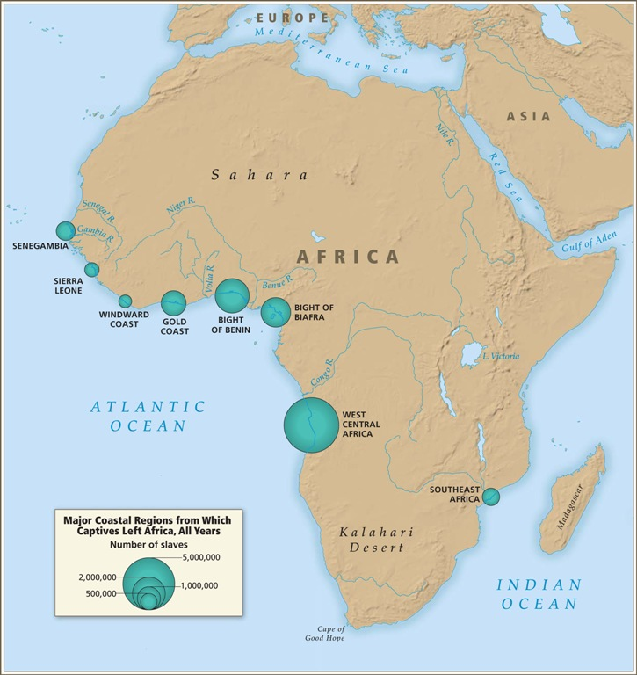

Slide 8
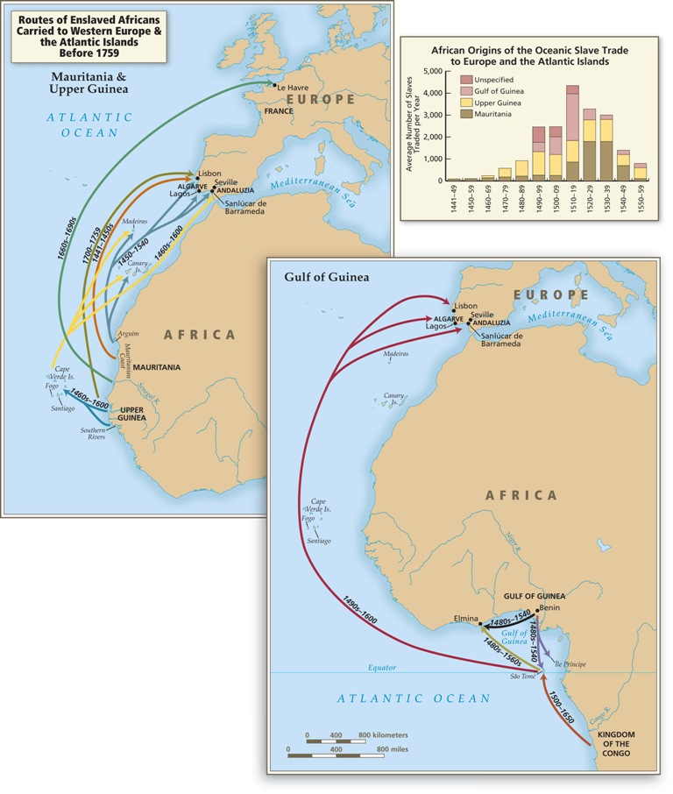

Slide 9
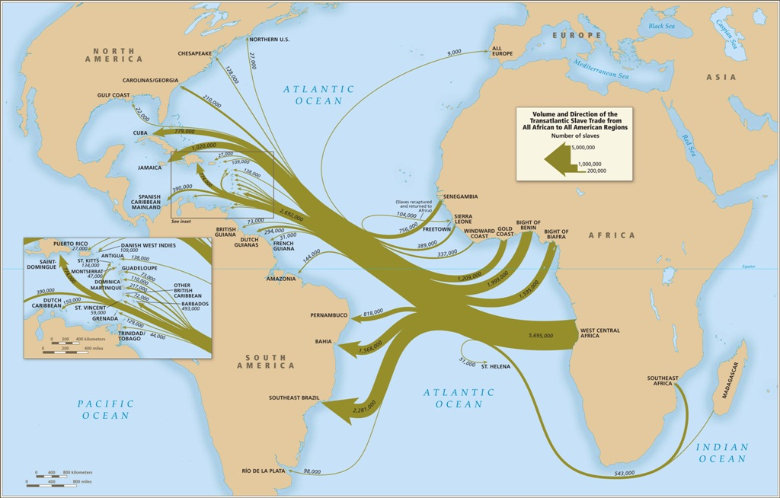

Slide 10
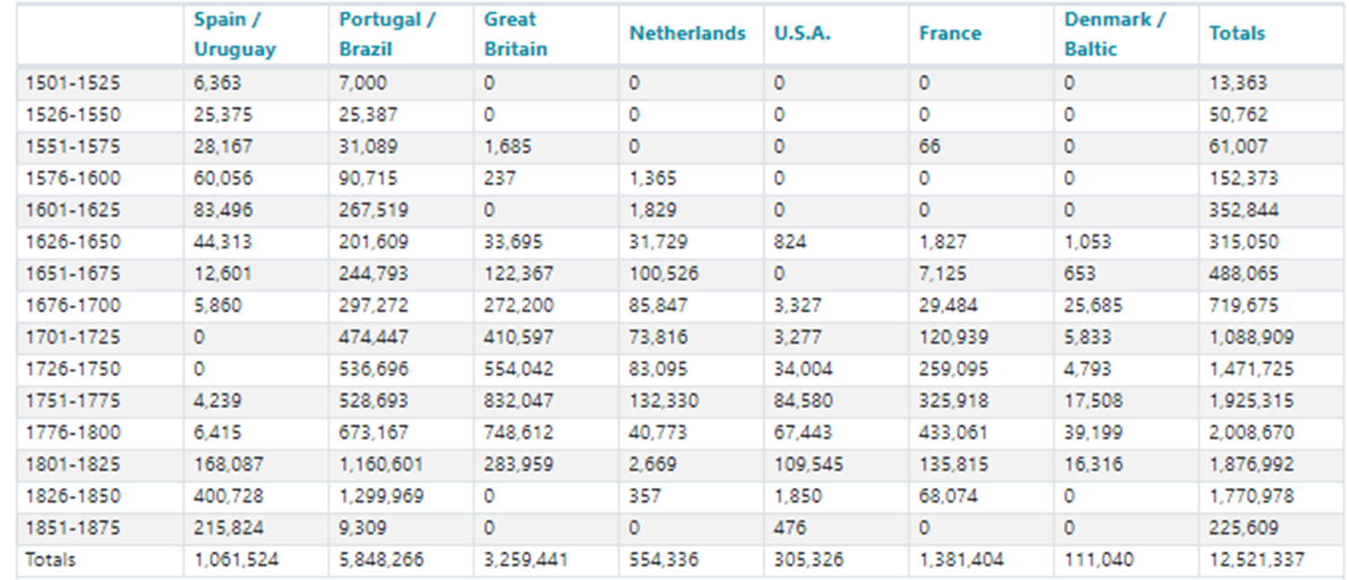
Statistics

Slide 11
u.s. Impact
Created race based society rather than economic class
Colonial Government furthers laws to benefit whites rather than slaves
No race mixing, even if free
  One drop rule
Most U.S. Presidents prior to 1870 owned slaves
Naturalization law of 1790- Only citizens are whites

Slide 12
U.S. Impact
Without invention of cotton gin cotton would not have been profitable in south

