Slide 1
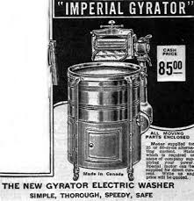
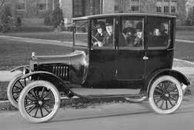
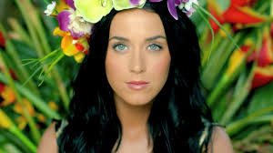
It’s the 1920’s Hear us consumers Roar!

Slide 2
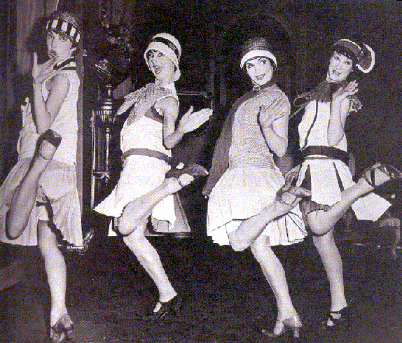
Rising middle class
More leisure time
Many consumer products
Increased autos & travels
Gangsters and bootleggers
Mass media & popular culture
“loose” society “vs.
“moral” society”
“ROARING”
1920’s

Slide 3
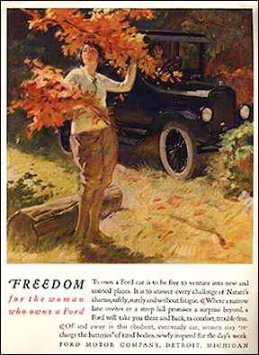
The New Middle Class
Americans are influenced by new advertising and marketing techniques
Americans buy appliances, cosmetics, commercially processed foods, mass produced autos, new fashions.
Consumption =dominant cultural ideal
Installment Buying Plan. “Buy Now - Pay Later.”

Slide 4
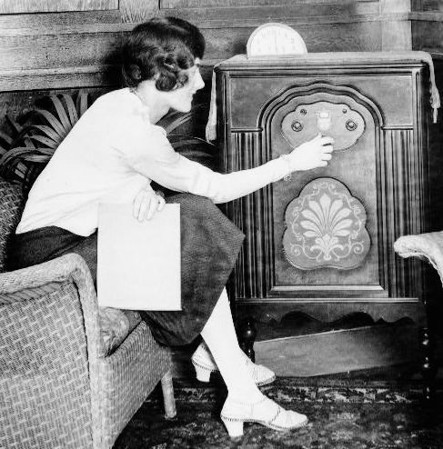
Radio- 1st commercial station broadcasts in 1920
Radio stations feature news, sports events, variety entertainment and live musical broadcasts.
New leisure time initiates the building of playgrounds, parks, swimming pools, golf courses, tennis courts, and ball fields.

Slide 5
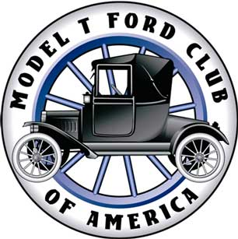
Model T
Henry Ford established the assembly line to manufacture inexpensive automobiles for the general public.
Three impacts of the automobile.
1. Mobility beyond their backyards
2.New industries included road building, gas stations and auto mechanic garages.
3.Rural areas less isolated

Slide 6
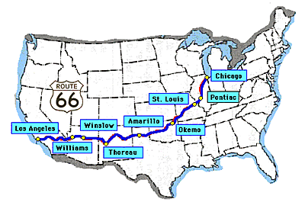
The impact of the automobile
- In 1927 Ford introduced the new Model A’s
- Route 66 – the major road between Chicago and Los Angeles. Lots of towns popped up along the route to offer places to stop.
- Houses started to be built with garages and driveways
- It allowed people to vacation in faraway places

Slide 7
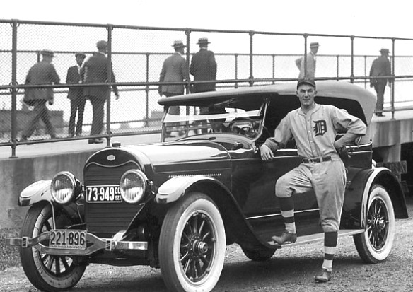
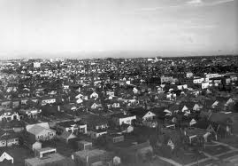
created urban sprawl – cities spread in all directions as people moved further from their jobs.
- end of 1920’s – U.S. citizens owned 80% of all the automobiles in the world

Slide 8
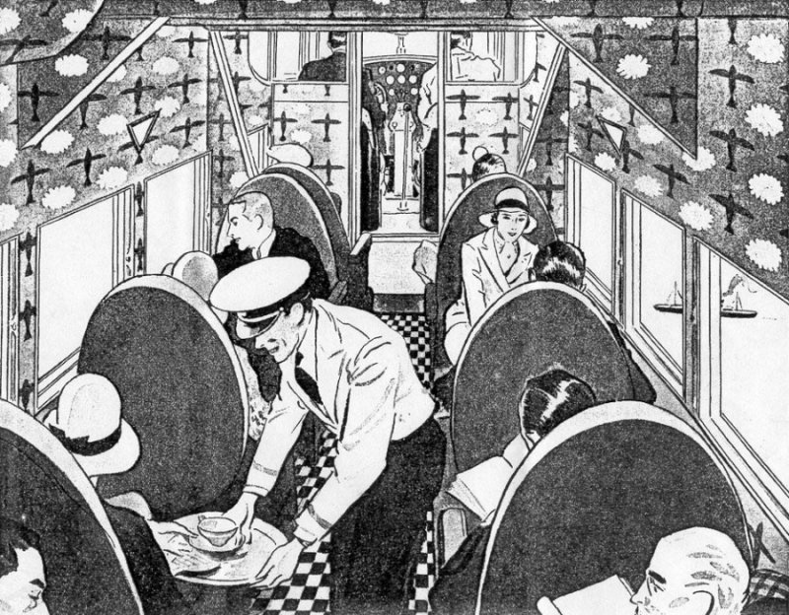
Young airplane industry
- Began as a mail carrying service for the U.S. Post Office
- Late 1920’s saw the first passenger flights

Slide 9
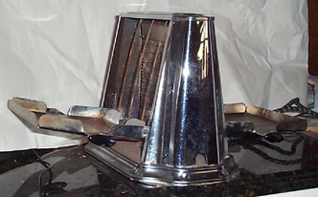
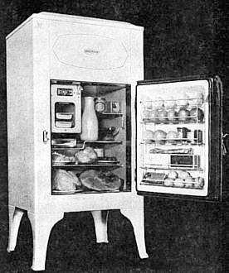
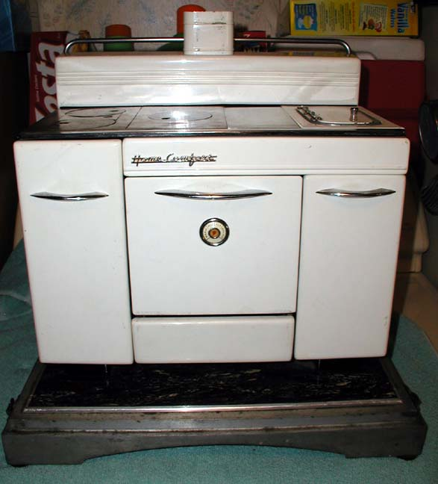
Electrical conveniences
- Gasoline and electricity powered much of the economic boom of the 1920’s
- Electricity could be distributed further to the suburbs
- By the end of the 1920’s, well to do families had electric irons, refrigerators, cooking ranges, and toasters.

Slide 10
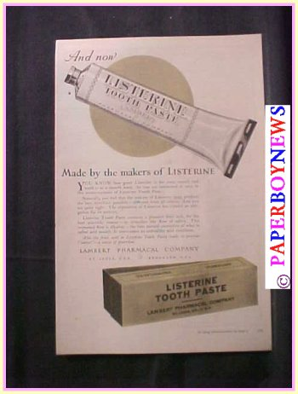
- new products flooding the market
lead to more print and radio advertising.
A superficial prosperity
buying on credit
Overconsumption of goods
Lead to financial problems for individuals and families

Slide 11
The Soaring Stock Market
Mass production: cars, radios, refrigerators.
People could buy on credit. There is massive consumer spending.
Confidence that Prosperity was here to stay!!
With more money to spend people invested on the stock market.
American industry booms, price of shares move up
Investors sell their shares at higher prices and make huge profits
Get Rich, Quick!!
More people invest, pushing prices higher
Let’s get RICH!!!!

Slide 12
Consumer Culture’s
Partners
Do you think the U.S. is a consumer culture today? Why?
What kinds of items are representative on a consumer culture for 2014?
How do they differ from the 1920’s?
How are they similar to the 1920’s?

