Slide 1
Expansion of Industry in the Gilded Age

Slide 2
Gilded Age
Gilded Age is the time between The Civil War and WWI
The Gilded Age-
The rise of industry and corruption within it
Immigration to the United States and taking advantage of cheap labor
The progressive movement in reforming the culture and business corruption in the United States

Slide 3
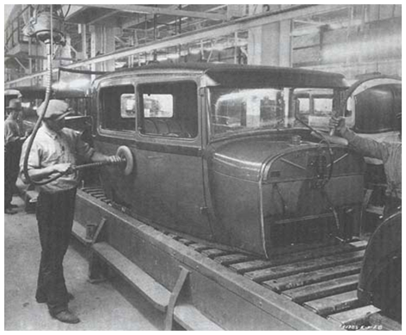
Gilded Age Industry and Mechanization
Standardized parts
Mass production
Routine labor
Low wages
De-skilled labor
Job hierarchies
Increase in technology

Slide 4
Gilded Age Economy
The economy grows 400% between 1860-1900
This booming economy brings increased infrastructure- R.R’s! and government support
Natural Resources become the fuel to the economy
Coal, Iron Ore, Oil,
There was more and more need for these goods in production
So they were mined out of the earth and delivered to growing cities

Slide 5
Gilded Age Economy
The key element to economic growth is steel!
Used as a building block to cities and infrastructure

