Slide 1
Thousands of years of North American History

Slide 2
The Beginning
Native American Indians walk across the land bridge between modern day Russia and Alaska thousands of years ago
North America’s diverse land provides an environment to grow crops and sustainable life through hunting and gathering

Slide 3
The Beginning
In 1492 Columbus sailed the Atlantic Ocean looking for India- found the Caribbean
Late 1500’s-1600’s Europeans develop Colonies on east coast for:
religious freedom
economic opportunity

Slide 4
The Beginning
Columbian exchange of goods from North America to Europe
Most food and diseases
In efforts to cheapen labor slaves from Africa are brought to North America.
Blacks selling Blacks not Whites

Slide 5
The Beginning
French, Spanish, Portuguese, English and Dutch continue to search the New World for resources and areas to settle
The North American colonies mostly controlled by the French/British becoming trading places bringing resources back to England without profit and high taxation

Slide 6
The Beginning
New colonists become upset with economic system and taxation in place and stage a revolution
Battle for independence is fought. 1776-1783
Colonists Win
Build a new nation- call is United States of America

Slide 7
The Beginning
Come up with laws and rights each citizen has in new country.
Political parties surface dividing opinion on how to run country, but it good for country's diverse thinking
Slave trading still exists
America is in need of reform it’s getting out of control
Workplaces are unsafe, child labor is used, and low wages
People are still flocking to America for opportunities

Slide 8
The Beginning
The country is beginning to divide
Have and Have not’s. Rich and Poor. North and South, For slavery and against slavery
The nation continues to grow
Slavery or not slavery depending on where in America
Abe Lincolns of the Republican Party is elected
The south has had enough and succeeds from Union

Slide 9
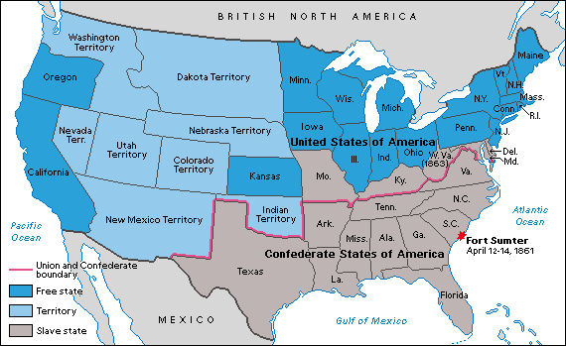
War! 1861

Slide 10
Legacy
From your prior knowledge what is The Civil Wars legacy?

Slide 11
Legacy
One thing that is always talked about with The Civil War is its casualties and the lives affected by the war
http://www.civilwar.org/
http://www.civilwar.org/education/history/faq/
http://www.civilwar.org/education/civil-war-casualties.html
For assignment individually while searching find 10 things that you didn’t know or stats that shocked you about the The Civil War and a 4 sentence essay on the Civil Wars legacy.

