Slide 1
Immigration and Urbanization

Slide 2
Immigration
At the turn of the 20th century, America attracted people from all over the world
Economic opportunity
To find a better life
Escape oppression
Estimated 25-30 million people immigrated between 1850-1930!!!

Slide 3
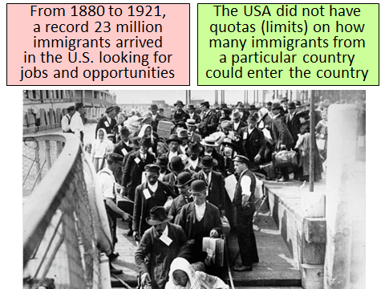

Slide 4
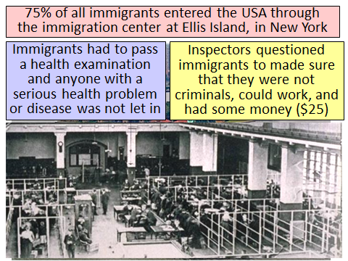
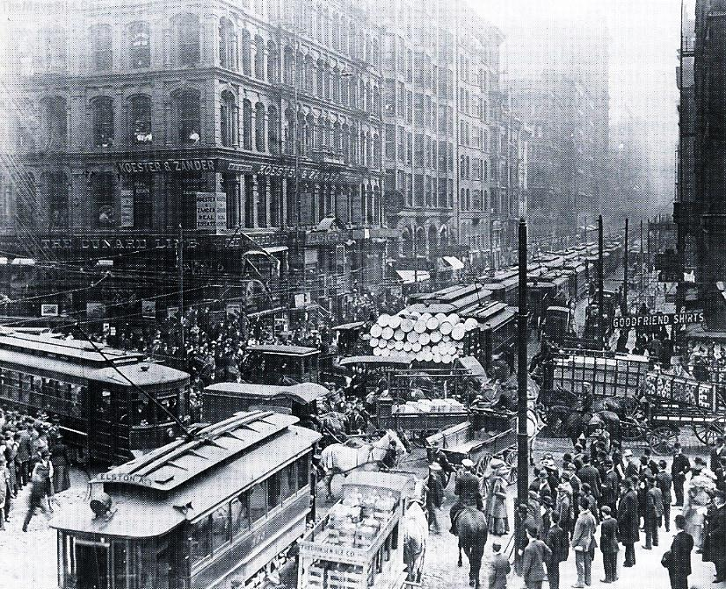

Slide 5
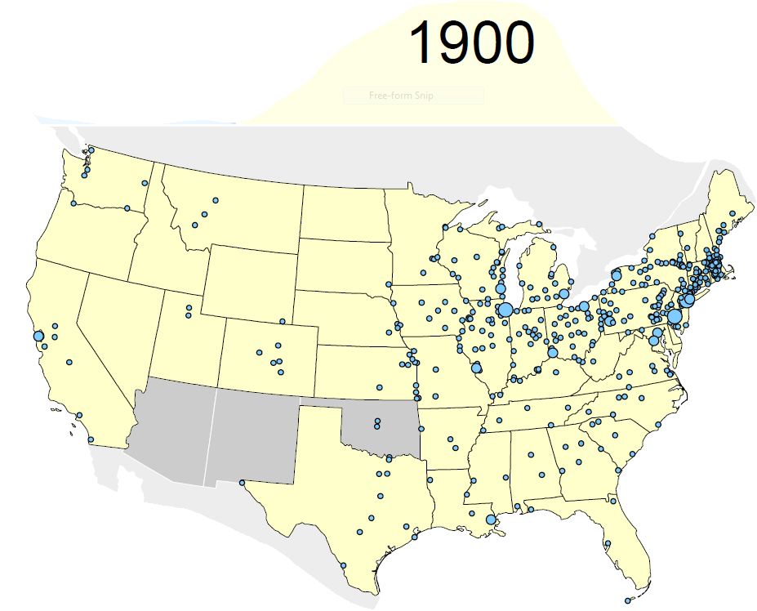

Slide 6
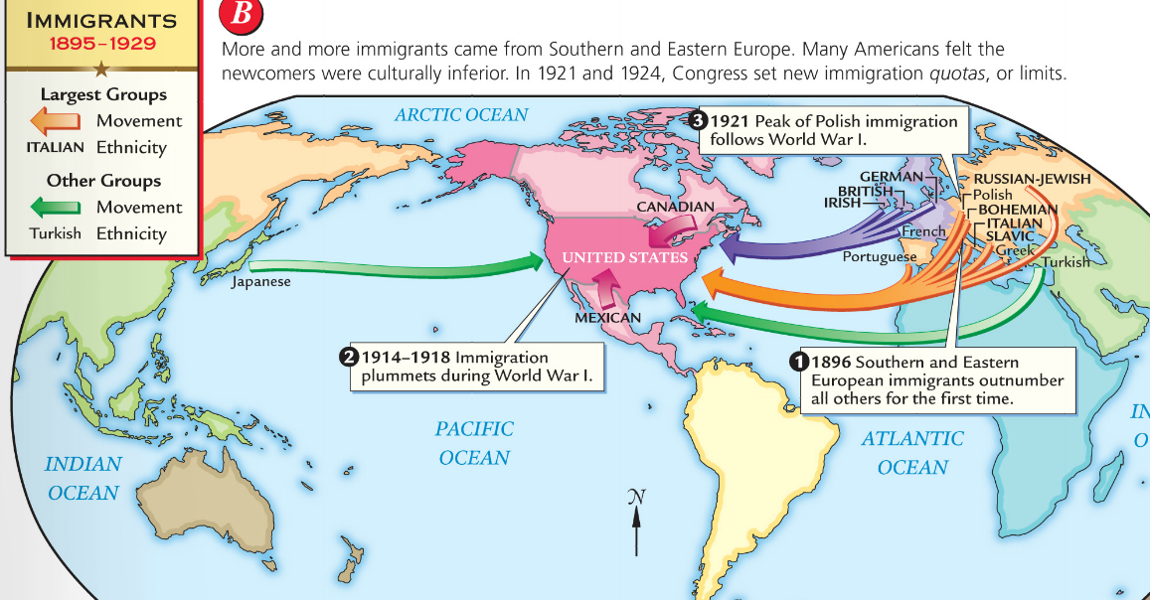
Between 1880 and 1921, 70% of all immigrants to the USA came from southern and eastern Europe (Italy, Poland, Austria-Hungary, Russia)
From the colonial era to 1880, most immigrants came from England, Ireland, or Germany in Northern Europe
The “new immigrants” were typically young, male, either Catholic or Jewish, and spoke little or no English
The majority were unskilled agricultural laborers with little money or education

Slide 7
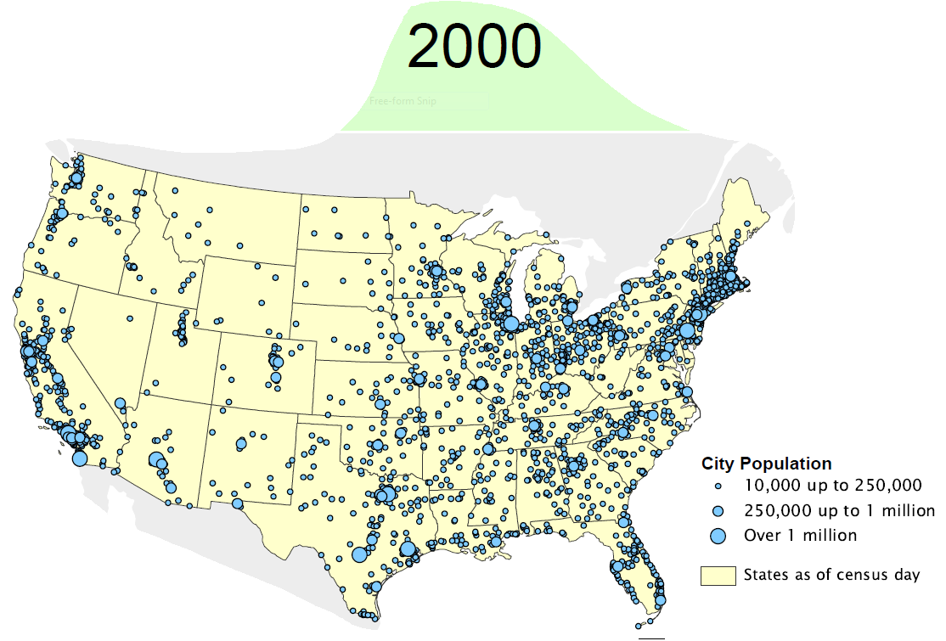

Slide 8
Immigration Article
How does the country change due to immigration?

Slide 9
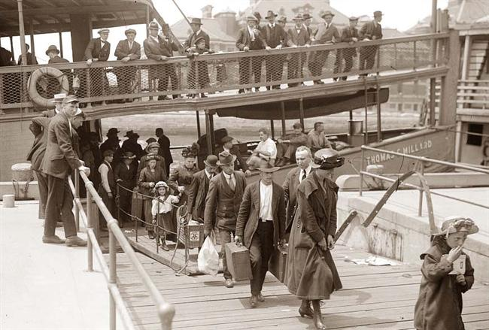
Where did they enter?
Angel Island - West Coast
More of a holding center for Asian immigrants
Ellis Island - An island off the coast of
New York where millions of people came through
on their way to America
It is estimated that 40% of Americans can trace their family to Ellis Island!
Ellis Island

Slide 10
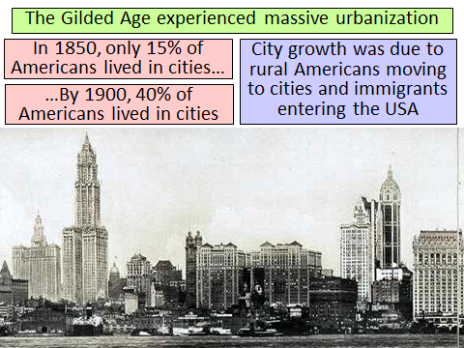
Urbanization

Slide 12
Urbanization
Although moving to the city was often brought with promise there were many problems
So many come so quickly not enough places to house everyone
The country may have been transforming it wasn’t always for the better

Slide 13
Urbanization
https://www.youtube.com/watch?v=nYXfvl_rF3M

