Slide 1
Israel

Slide 2
ISrael
To understand Israel you need to understand Judaism's history

Slide 3
Vocab and Key Points
Diaspora- Dispersion or scattering of people from their homeland-Jerusalem. Nearly none lived in or near Jerusalem
Since early centuries C.E.
Because of persecution for differences- Christianity vs Judaism-Relation to Jesus Christ as the Messiah- Jews as a prophet but not Messiah
Criticized for creating world problems- Black Plague, WWI-WWII Holocaust
Economic Successes and many more

Slide 5
Vocab and Key Points
Zionism- Political and nationalism movement of Jews and Jewish culture to support having one homeland
This movement came together in the 19th century in Europe to nationalism took over Europe.
Jews wanted to re-establish a Jewish nation-Israel

Slide 6
Israel - Historical Context
Became a state in 1946 after WWII
A safe haven for Jewish refugees after the Holocaust
Allies with the US and part of the United Nations
Jewish Democratic State
Representative Democracy - Prime Minister is head of state
A developed country
Highest standard of living in the Middle East

Slide 7
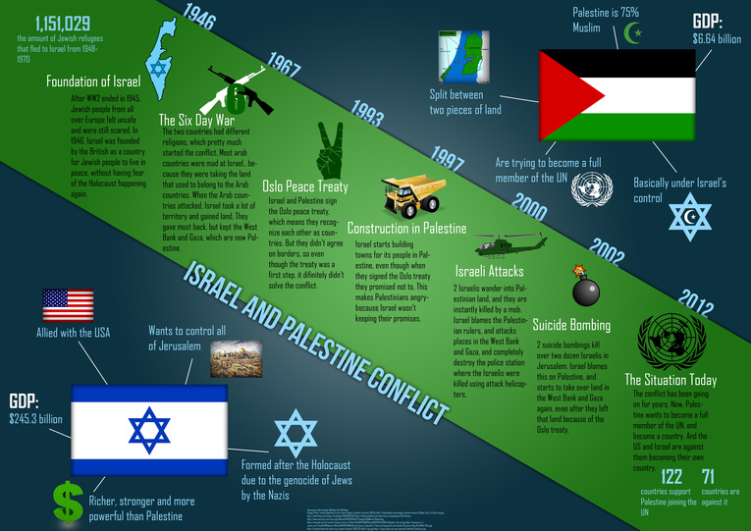

Slide 8
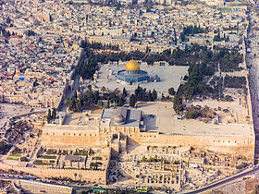
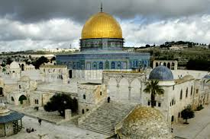
So what’s the problem?
Israel is located in a very important location
The 3 major world religions stake claim to the Holy Land
Jerusalem is a sacred city in Islam, Judaism and Christianity
Both Israel and Palestine claim it as their capitol
The Temple Mount - Sacred Temple that holds God’s Justice

