Slide 1
Labor Unions Emerge

Slide 2
Unionization
At this time things:
paid vacation
sick leave
collecting unemployment
workers compensation
Didnt exist

Slide 3
Unionization
Many were dying on the job and no family compensation
Dirty factories
Poor ventilation
14 hour days

Slide 4
Unionization
Along with having low wages many jobs became easily replaceable doing easy tasks
Could fire you with little reason-No follow up action
Could easily get other workers to do the job

Slide 5
Child Labor
Worked in sweatshops- clothing factory with long hours and low wages
25% of boys had jobs under 15
10% of girls had jobs under 15
14 hour days
Making cents on the dollar- $250 a year
Schooling?
Articles

Slide 6
Unionization
Workers that were both skilled and unskilled began believe that the way they were being treated was unfair.
Unionization started locally with workers with the same jobs
Steelworkers, miners, shoe makers
At this time things like paid vacation, sick leave, collecting unemployment, and workers comp. didnt exist

Slide 7
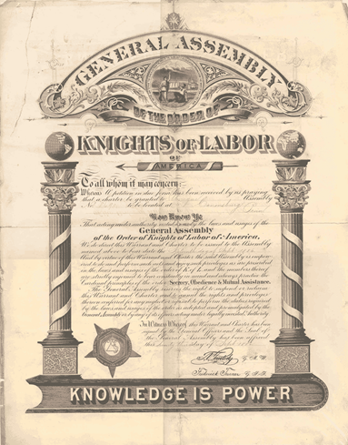
Unions
National Labor Union- First organized labor union
The Knights of Labor- Organization of over 700,000 develops to try and gain bargaining power
end wage slavery
attack capitalism
give workers a voice
better working conditions
8 hour workday

Slide 8
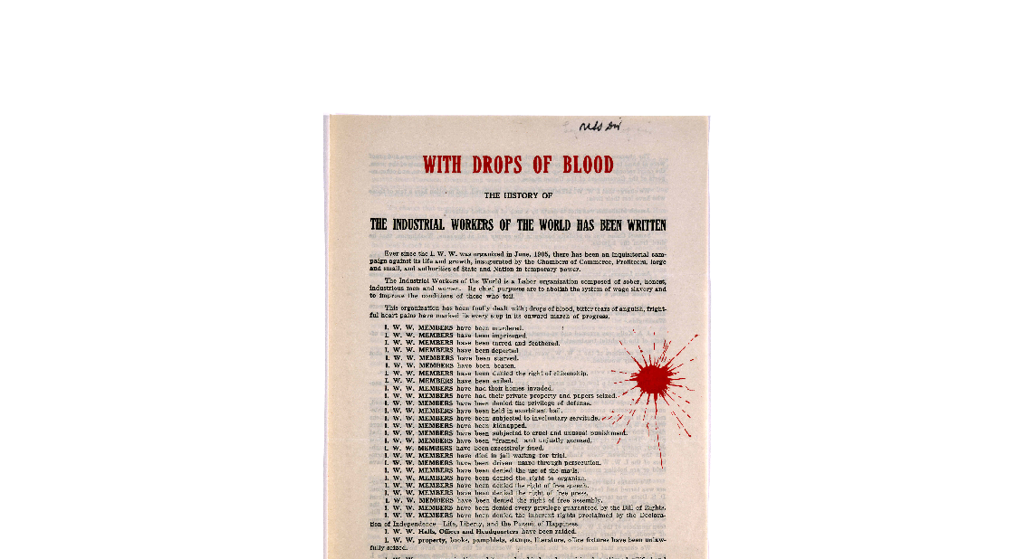
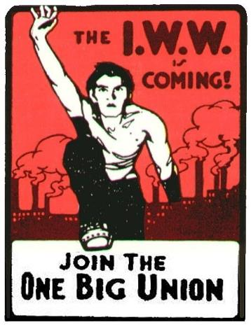
International Workers of the World
Founded 1905 by radical Colorado miners
Known as IWW or “the Wobblies”
“One big union”: all laborers, regardless of race or trade
Often supported violence and sabotage
Collapsed during WWI and Red Scare
https://www.loc.gov/resource/rbpe.01805500/

Slide 10
Owner Vocab
Often times owners used scare tactics in possible firing workers or cutting wages
Research the book definition of the term, but put them in your own words
Yellow Dog Contracts- Scab Workers-
Blacklist-

Slide 11
Labor Vocab
Workers also had tactics of their own to try to get the rights they wanted.
Research the book definition of the term, but put them in your own words
Arbatration-
Boycott-
Strike-

Slide 12
