Slide 1
Post WWI

Slide 2
The Election of 1920
Voters want to put the war and problems here at home behind them
Republican candidate Warren G. Harding promises “a return to normalcy.”

Slide 3
Turmoil in the 20’s Roaring and Bad
Bad
Communist Paranoia
Religious Unrest
Racial Unrest
Roaring
Technology Advances
Culture of Change
Counterculture

Slide 4
Isolation and Nativism
Nativism – belief that native people (people who were born in the country) are superior to immigrants
Oppose immigration
Immigrants are looked at as hostile and not trust worthy

Slide 5
Immigration Quotas
Congress establishes quota system 1921 require only a max number of immigrants can come in from foreign country's
Each European nations could only could only have 2 % of current population in U.S. immigrate per year
Very discriminatory against Catholics and Jews
Law didn’t apply to Western Hemisphere countries

Slide 6
The RED SCARE
Strikes & race riots, blamed on foreigners / communists
Communism - a system in which property is owned by society as a whole instead of by individuals.
Government feared Russia and Communism would take over U.S.

Slide 7
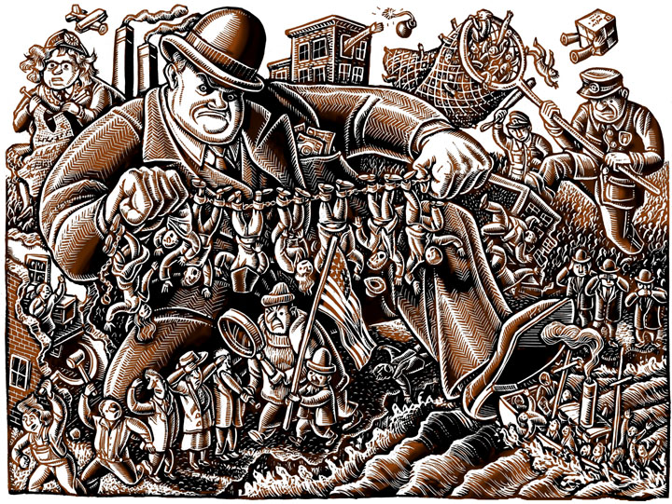
Red Scare
U.S. Government made sure there were no Communism sympathizers or radicals that wanted to join Russia

Slide 8
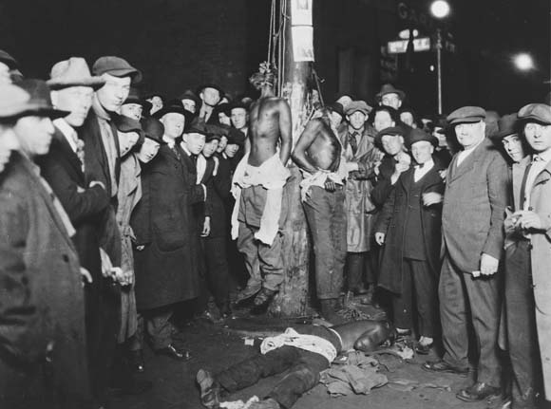
Racial Unrest
1917-1919 Race riots
occurred in Houston,
Philadelphia, Chicago
White mobs terrorized black communities
Since 1890, thousands of blacks died in lynchings in the South.

Slide 9
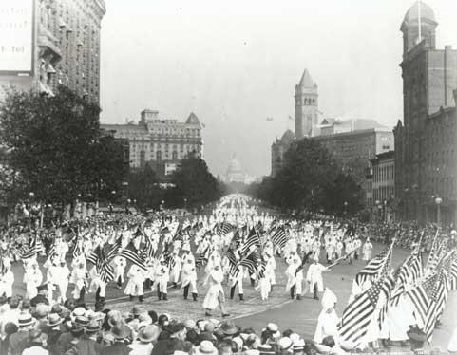
Ku Klux Klan
Post war – “new” Klan – white, native born
They directed their hatred against anyone who was “different”
Targeted Catholics, Jews, Asians, and immigrants & African Americans
Were a violent
terrorist group
4 million members by
1925!

Slide 10
The Good

Slide 11
Advancements in Technology
New technology added economic and cultural growth
Economic
New Jobs
New markets for good
Investing opportunities
New Business
Cultural
Major Consumers
Luxury lifestyle
Make it rich culture

Slide 12
1920’s Technology
A turning point in technology for U.S.
Consumer goods- automobiles, radio, television, airplanes,
dishwasher, speaker, and sliced bread
Medical goods- Insulin, Band-Aids, and penicillin
1920’s Inventions change the world
http://www.history.com/topics/roaring-twenties

