Slide 1
Power

Slide 2
Money and Power
I want you to write down which of these is more valuable and why?
Money or Power

Slide 3
Money and Power
What can money do?
What can power do?
Can money buy power?
Is power more valuable? Why or Why not?

Slide 4
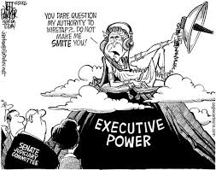
Power
Who has Power?
Why do people have Power?
How did they earn that Power?

Slide 5
Types of Power Activity
With the people around you come up with a list of ways a person has power?
There power in ___________.

Slide 6
List
Now where does all this power come from?

Slide 7
5 Sources of Power
Reward power: Ability to give.
Can come from all leaders
Coercive power: Fear and punishment.
Ex. dismissals, reprimands, etc.

Slide 8
5 Sources of Power
Legitimate power: Derived from formal authority
Appointed power.
Expert power: Specialized skills, knowledge, or expertise.
Referent power: A.K.A. Reference
Based on respect or admiration.

Slide 9
Key types of power
For the most part there are two main types of power
Social Power
Governing Power

Slide 10
Social Power
Influence money
Influence decisions
Create social change
Trend setters
Discussion
Do the Kardashians have power?
Is there power in social media?

Slide 11
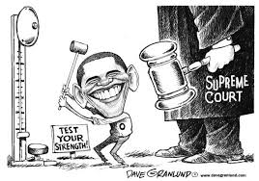
Organizational Power
Make Laws
Govern people
Run businesses
Creates a hierarchy or chain of command
-Local-State-Federal-World
Discussion Question
Is there a flaw with Power?

Slide 12
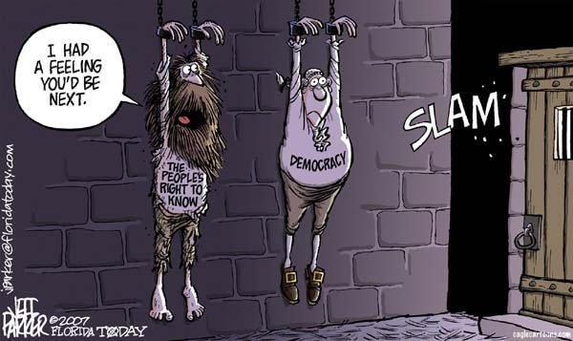
Why Power Corrupts
http://www.smithsonianmag.com/science-nature/why-power-corrupts-37165345/?no-ist

