Slide 1
Progressivism

Slide 2
Progressivism
WHEN? “Progressive Reform Era”
1890s
1901
1917
1920s
WHO? “Progressives”
urban middle-class: managers & professionals; women
WHY? Address the problems arising from:
industrialization (big business, labor strife)
urbanization (slums, political machines, corruption)
immigration (ethnic diversity)
inequality & social injustice (women & racism)

Slide 3
Progressive Movement
Trying to make things better
Move the country forward
There was a need for this because of no government regulation of business or society
Modern ideas create a renaissance of scientific and technology thoughts to make more efficient and effective

Slide 4
Main Goals of Progressivism
In the Progressive Era a social and political movement began to try to change the ills of society in the Gilded Age
Progressivism- A responses to political, economic, and social problems of the Gilded Age to promote change.
Main Goals of Progressivism
Protect social welfare
Promote moral improvement
Economic reform

Slide 5
Social Welfare
Main Objectives and Organization development
Jane Addams, Florence Kelley
Ending child labor
Decrease women’s working hours and instead raise family and improve lives of women.
YMCA develops to create place for kids to go and play
Salvation Army is created to assist in feeding the poor

Slide 6
Moral Improvement
Main Objective and Goals
To Improve social behavior
Temperance Movement begins to take shape
Trying to ban alcohol
What was happening is abusive of women and children from men after work

Slide 7
Political and Economic Reform
Eugene Debs
Goals and Objectives
Create fair playing field
Slow capitalism- brings Socialism- equality for all
Connect the corruption with business to government
Hold business to higher standards of business practices and ethics

Slide 8
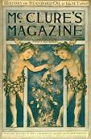
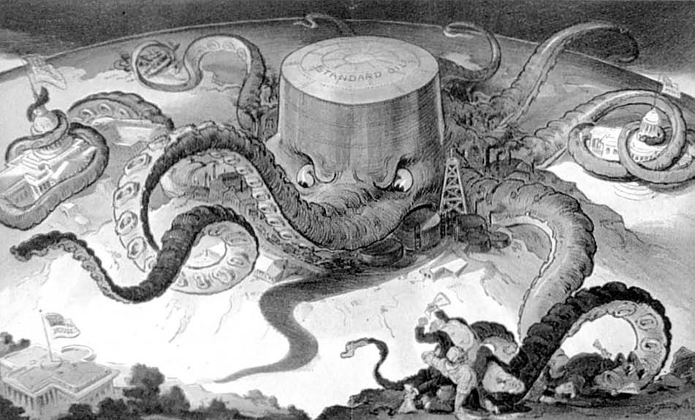
Who were the muckrakers?
Ida Tarbell —criticized unfair business practices like trusts. Wrote “History of Standard Oil”

Slide 9
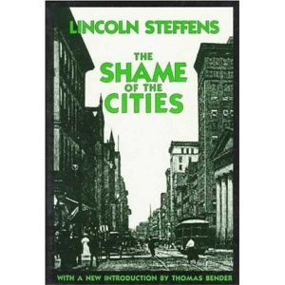
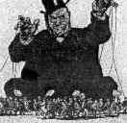
Lincoln Steffens Shame of the Cities
Exposed corruption in urban politics.

Slide 10
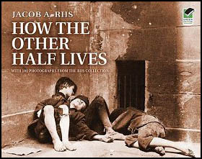
Jacob Riis How the Other Half Lives
Photographer, exposed poverty in NYC immigrant neighborhoods.

Slide 11
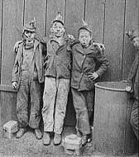
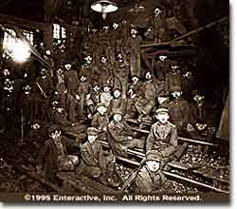
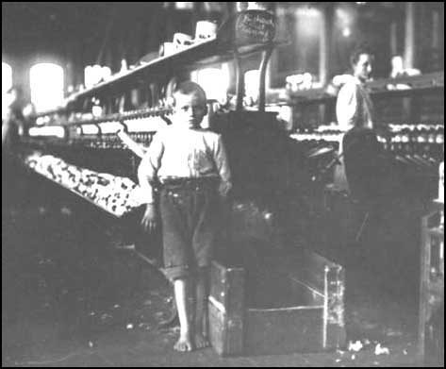
John Spargo The Bitter Cry of the Children
Child labor

Slide 12
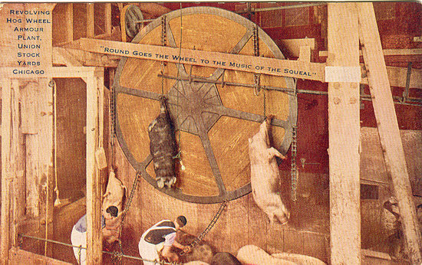
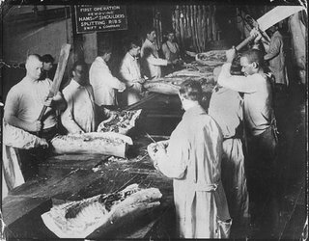
Upton Sinclair The Jungle
Exposed unsanitary conditions in meat-packing industry

Slide 13
Big Question
What are some areas today society needs to progress in?

