Slide 1
Sharecropping

Slide 2
Sharecropping
Does anyone have a job they work?
For a company not their chores
If so, of the net pay you make do you share that money with anyone else?
Do you share that money involuntarily?

Slide 3
Sharecropping
Sharecropping- is a system of agriculture in which a landowner allows a tenant to use the land in return for a share of the crops produced on the land.
Simulation

Slide 4
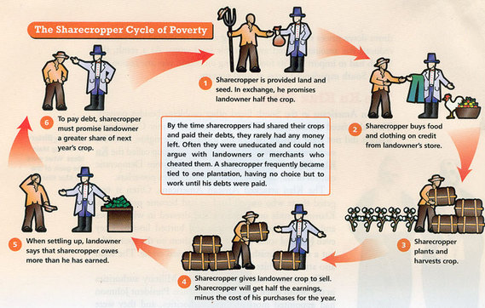
Sharecropping Cycle

Slide 5
Sharecropping Reflection
Those who had Profits- More than 0
Tenant Farmers- Might be able to rent land for cash and keep all harvest
Those who were in debt- Less than 0
Keep working the land until you get out of debt!
What was the most unfair part?
Did you have any rights?
13, 14, 15
Activity

Slide 6
End of Reconstruction
Cotton prices crumble in 1870’s
Farmers tried to grow more
Although economically the more supply of crop the cheaper it gets- made the problem even worse!

Slide 7
End of Reconstruction
The KKK a rebel terrorist group develops to frighten African Americans
KKK often scared African Americans to stay away from polls after 15th
Lots of disputes in years in between 1870-1877
To end Reconstruction there is the Compromise of 1877

Slide 8
End of Reconstruction
1876
2 candidates Democrat Sam Tilden vs Republican Rutherford B. Hayes
Tilden wins the popular vote but not the electoral college
Republican ruled the Election Commision
Democrats ruled the House
As a trade Democrats give up Presidency but want things in return
Removal of troops from South
Money for a southern railroad to reach the west
Cabinet members

Slide 9
End of Reconstruction
Discuss was Reconstruction a success?

