Slide 1
The Enlightenment & Great Awakening
Chapter 4

Slide 2
The Enlightenment
Ideals combined confidence in human reason with skepticism toward beliefs not founded on science or strict logic
Sir Isaac Newton > explained gravity
Demonstrated harmony of natural laws and stimulated search for rational principles in medicine, law, psychology, and government
Benjamin Franklin
Poor Richard’s Almanack > collection of proverbs that made him famous > made enough money to retire at 42 > devoted to public service and science
American Philosophical Society > amateur scientists in colonies

Slide 3
The Enlightenment
John Locke
English philosopher
Essay Concerning Human Understanding (1690)
Ideas are not inborn, but acquired by investigation of and reflection upon experience > Tabula Rasa (blank slate)-Not born with
Deists
Believed that where Bible conflicted with reason, one should follow reason
Ben Franklin, Thomas Jefferson, Thomas Paine
God, having created perfect universe, did not intervene in workings, but left it alone to operate according to natural laws (clock-worker theory)

Slide 4
The Enlightenment
Colonists influenced by Enlightenment:
Described themselves as Christians and attended church
Value in religion in its encouragement of virtue and morality
Drew on ideas when declaring independence from GB and founding new nation

Slide 5
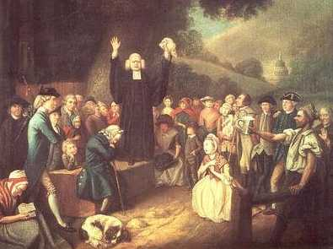
The Great Awakening
Outpouring of European Protestant revivalism spread to N. America (1739)
Cut across class, gender, race
Represented unleashing of anxiety about sin and longing for assurance of salvation among ordinary people
Powerful, charismatic ministers
Appealed to audiences’ emotions, rather than intellect
Depictions of the emptiness of material comfort, corruption of human nature, fury of divine wrath, need for immediate repentance

Slide 6
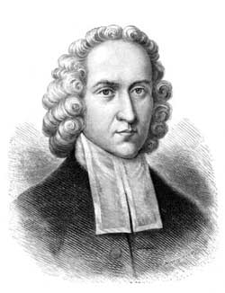
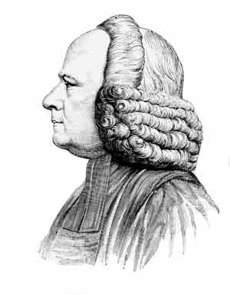
The Great Awakening
Jonathan Edwards
Northampton, Massachusetts revival (1735)
“Sinners in the Hands of an Angry God” sermon
“His wrath toward you burns like fire; He looks upon you as worthy of nothing else but to be cast into fire.”
George Whitefield
Toured America > Inspired thousands to seek salvation
Booming voice > crowd of 20,000 could hear him without a microphone
Converts = young adults in late 20s

Slide 7
The Great Awakening
Gilbert Tennent and James Davenport
Appealed to poor and downtrodden
Sparked opposition to revivals among established ministers and officials
Revivalists = New Lights
Rationalist Clergy = Old Lights
Dominated Anglican, Presbyterian, and Congregational churches

Slide 8
The Great Awakening
Splits in American Protestantism
New Lights: hinted that ministers lacked saving grace and were bound for hell
Sowed seeds of doubt about individual ministers
Old Lights: condemned revival as epidemic of enthusiasm > unleashed “a sort of madness”

Slide 9
The Great Awakening
Long-term effects exceeded immediate impact
Revival marked decline in influence of Quakers, Anglicans, and Congregationalists
Contributed to weakening of officially established denominations
Creating more religious pluralism throughout middle and southern colonies especially
Founding of new colleges
Old and New Lights sought institutions free of each other’s influence
New Lights: College of NJ (Princeton); King’s College (Columbia), Dartmouth College
Revivals spread beyond white society
Emphasis on piety over learning as key to God’s grace led Africans and Native Americans to combine traditional cultures with Christianity
Black Protestantism > New Lights reached out to slaves;

Slide 10
The Great Awakening
Long-term effects:
Added to white women’s religious prominence
Some New Light churches granted women the right to speak and vote in church meetings
Revivals blurred denominational differences among Protestants
Emphasized need for salvation over details of doctrine and church governance > promoted coexistence of denominations

