Slide 1
South Post Civil War

Slide 2
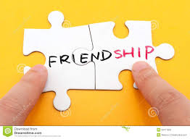
Reconstruction
Reconstruction begins
What is reconstruction?
Cant we just get back together? No big deal!

Slide 3
Reconstruction
What happens now to African Americans?
Emancipation Proclamation
http://goo.gl/UZrJ1B
Nearly 4 million freed slaves!

Slide 4
Reflection
I want you to put yourself in the shoes of a White slave-owner
What kind of emotions do you feel?

Slide 5
Post Civil War
The Aftershock!
https://youtu.be/oIC8ifQlDVY 0-4:18
Thoughts?

Slide 6
Post Civil War
Most of the south is in ruins!
Southern economy collapsed!-Cotton dependent, no more Queen of England money as well! No Industry!
Divided views on how to solve the reconstruction

Slide 7
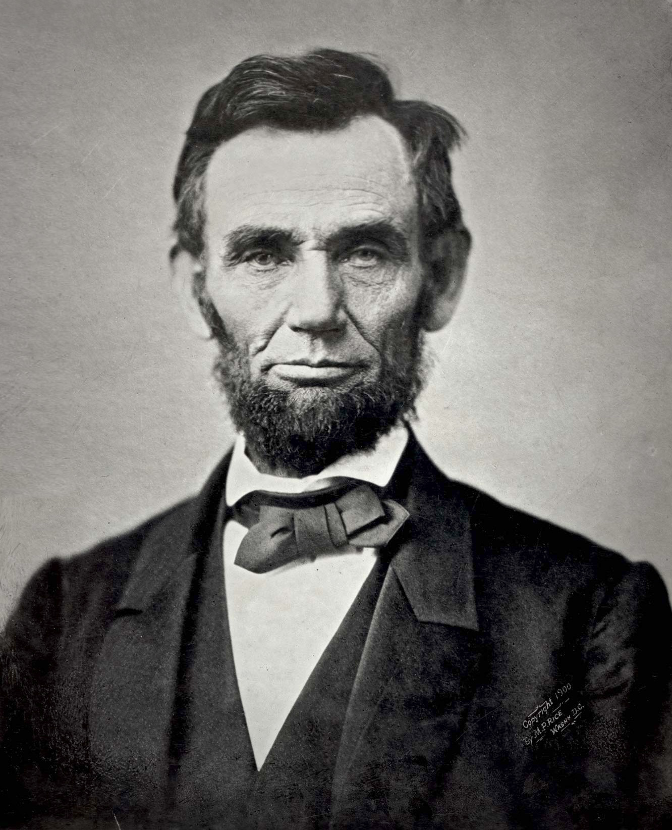
Post Civil War
Ultimately just days after the hysteria of ending The Civil War President Abraham Lincoln is shot!
Reflect
How does this change reconstruction?

