Slide 1
What is Propaganda

Slide 2
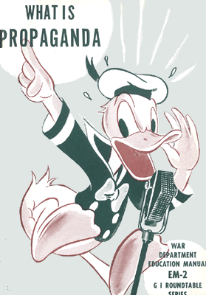
What is propaganda?
A way of manipulating people using images and words to achieve a desired affect or outcome

Slide 3
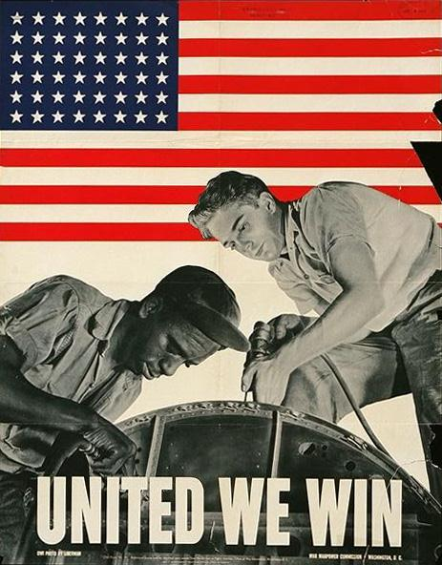
Partner Analysis
List on Board
1
Emotion?
Purpose?
Message?

Slide 4
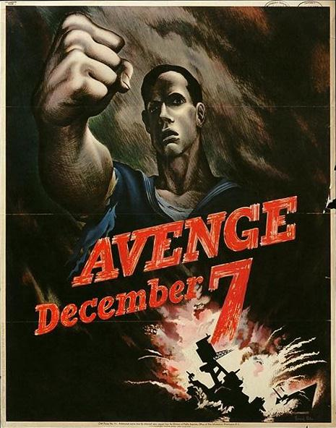
2
Emotion?
Purpose?
Message?

Slide 5
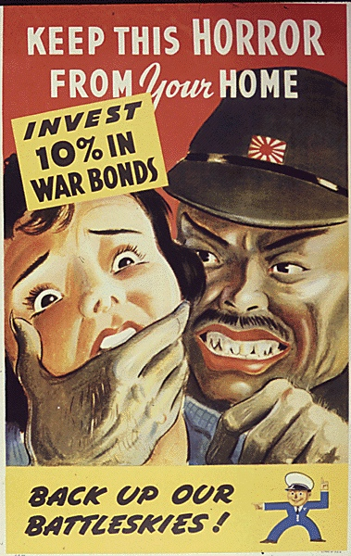
3
Emotion?
Purpose?
Message?

Slide 6
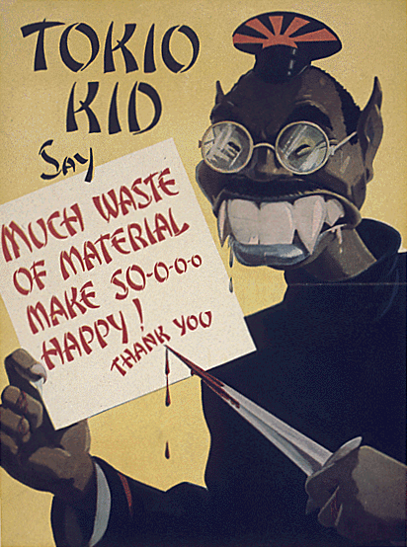
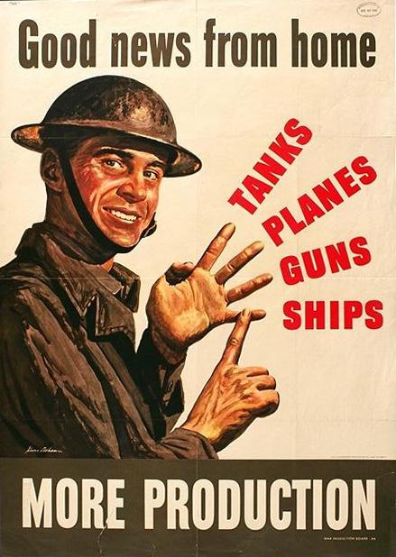
4
5
Emotions? Messages? Purpose

Slide 7
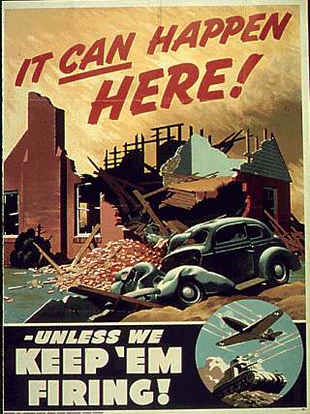
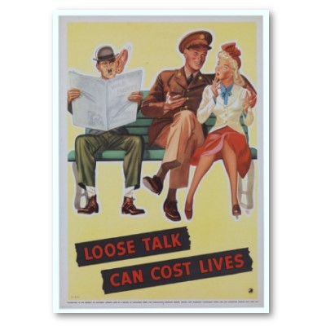
6
7
Emotions? Messages? Purpose

Slide 8
8
Emotion?
Purpose?
Message?

Slide 9
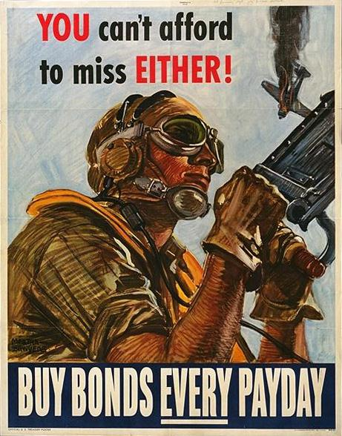
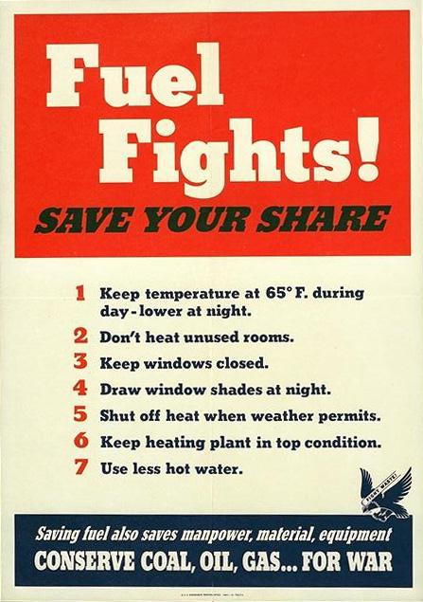
9
10
Emotions? Messages? Purpose

Slide 10
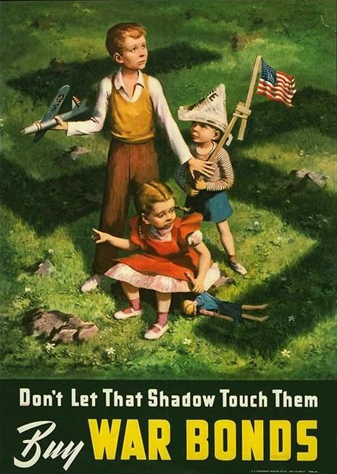
11
12
Emotions? Messages? Purpose?

Slide 11
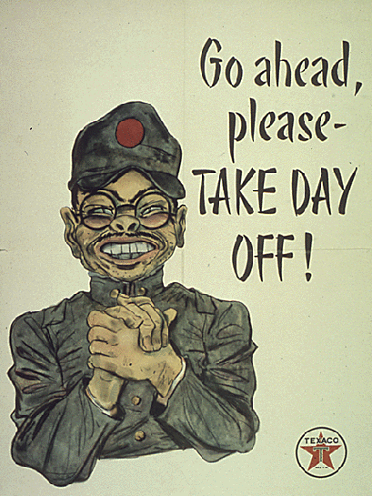
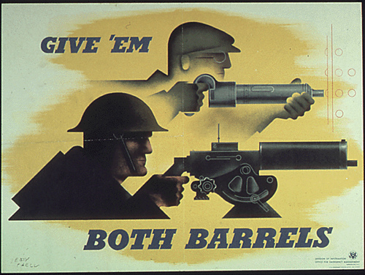
13
14
Emotions? Messages? Purpose?

Slide 12
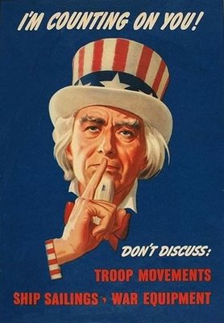
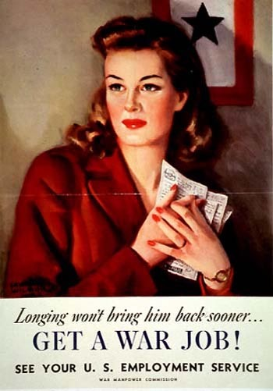
15
16
Emotion?
Purpose?
Message?

Slide 13
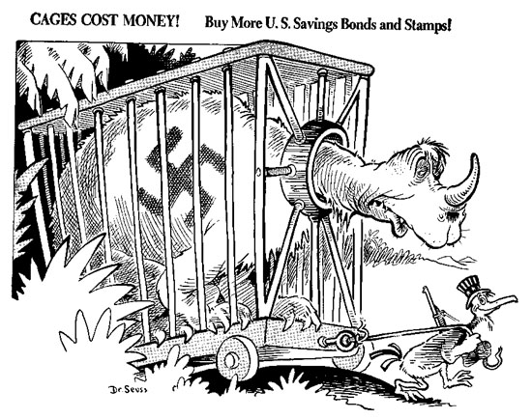
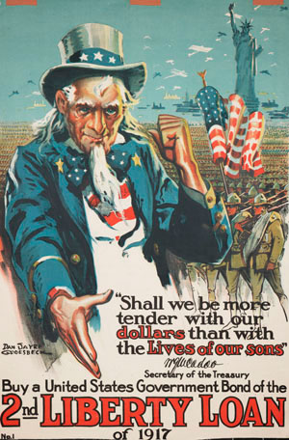
18
17
Emotion?
Purpose?
Message?

Slide 14
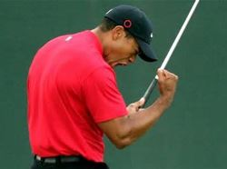
Create your own propaganda!

Slide 15
Instructions
Create a piece of your own U.S. mobilization and production propaganda
Use the sample pieces as a guide, not to copy!
Draw the image, your art isn’t graded!
Allowed to use markers, crayons, colored pencils, pen, pencil… be creative!
Just one piece of paper- I will provide printer paper
On the back of the page answer 2 questions
What is your image
What is your pieces message, purpose, and emotion
10 Points Due Tomorrow

