Slide 1
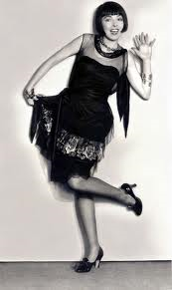
1920’s Women and Change

Slide 2
Daily Question?
Have women had reasons to rebel before the 1920’s?
Why Women Rebel Article

Slide 3
Changes in the Role of Women
After World War One :women had an increased presence in the factory workforce
Increased presence in college scene
Looked for more equality in their relationships
Dating changes-
Women courting Men

Slide 4
Women and the Vote
19th amendment gives women the right to vote in 1919/1920.
Women could now take part in politics and finally had a say in the way they were governed.
Gave them the freedom to exercise their rights and be recognized as human.
Further advanced the process of shrinking the gap in gender inequality.

Slide 5
Women and the Vote
Although in the 1920’s women tended to vote like their husbands, fathers, or other men in their lives.

Slide 6
Women in the Household
Women’s main responsibility was still the home, and depending on their mans support
Although an increasing number of women sought for equality in the relationship.

Slide 7
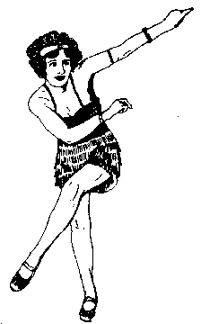
The MODERN Woman
Flashy new dress, bobbed hair and cosmetics
Liberated lifestyle
Often seen smoking, drinking, dancing, wearing makeup, attending lively parties
Most middle class women continued to stay at home as housewives and mothers
NOT representative of all women in the U.S.
Flapper
Article

Slide 8
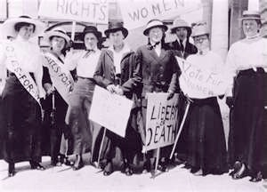
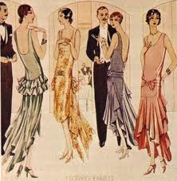
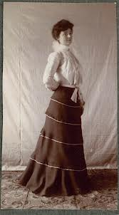
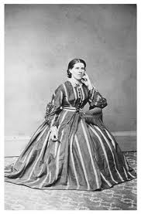
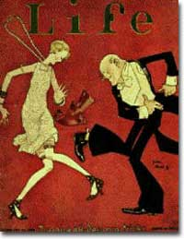
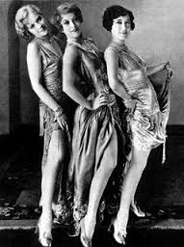

Slide 9
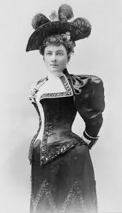
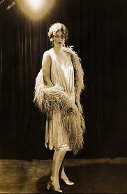
Partner Comparison
List and discuss the appearence differences with these two women pictured below.

Slide 11
Define a Flapper
Flapper- A woman with a lifestyle of great independence and freedom
Ultimately becomes a symbol of the 1920’s
Do you think Flappers of the 1920’s affect today?

Slide 12
Flapper Impact Discussion
In your opinion what was it about this social change that was so impactful to women of the 1920’s?
Traditionalist vs Modernist

