Slide 1
Women’s Rights

Slide 2
Early 19th Century Women
Unable to vote
Legal status of a minor
Single → could own her own property
Married → no control over her property or her children
Could not initiate divorce
Couldn’t make wills, sign a contract, or bring suit in court without her husband’s permission

Slide 3
“Separate Spheres” Concept
Republican Motherhood evolved into the “Cult of Domesticity”
A woman’s “sphere” was in the home (it was a refuge from the cruel world outside).
Her role was to “civilize” her husband and family.

Slide 4
Keys to know
Upper and Middle Class movement
Because able to focus time on movement because didn’t work-
Their focus was on the home
Lower Class had to work to support family
Worked in industry1860-1890’s in particular- canneries, packing, laundries, garment factories
1890’s- early 1900’s in particular- Teachers, book keeper, office- Needed to be High School Educated

Slide 5
19th Amendment Women’s Suffrage
Leaders:
Elizabeth Cady Stanton
Lucretia Mott
Susan B. Anthony
Julia Ward Howe
Alice Paul
Carrie Chapman Catt
Tactics: marches, speeches, picketing, hunger strikes

Slide 6
SENECA FALLS
The first Woman’s rights movement was in Seneca Falls, New York in 1849……
Educational and professional opportunities
Property rights
Legal equality
repeal of laws awarding the father custody of the children in divorce.
Suffrage rights

Slide 7
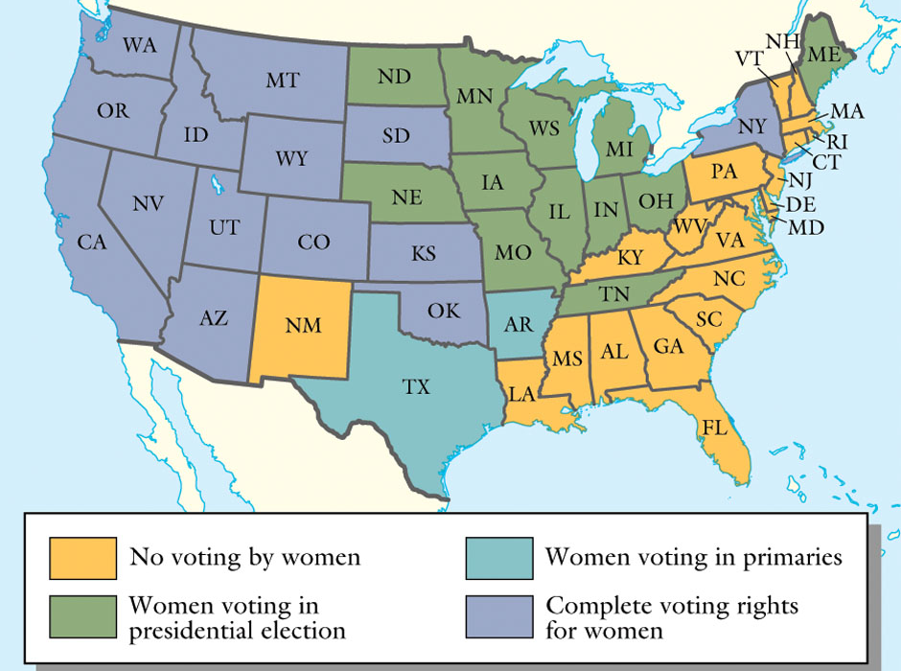
Woman suffrage before 1920
Notes:
Thomson Wadsworth Wadsworth.com

Slide 8
The Temperance Movement
In 1830, Americans drink an average of 5 gallons of liquor a year
The real problem is Americans have the habit of drinking all day
Heavy drinking led to many social problems including:
Decreased efficiency of work
On the job accidents
Breakdown of the family
Poor health
Poverty

Slide 9
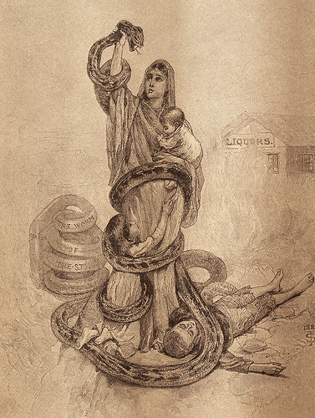
Demon Rum: The “Old Deluder”
The temperance movement organized because consumption of alcohol significantly increased & caused social problems
Goal: To encourage moderation in the consumption of intoxicating liquors or press for complete abstinence
Movement was led by churches and religious groups
Propaganda focused on the sufferings of innocent mothers and their children

Slide 10
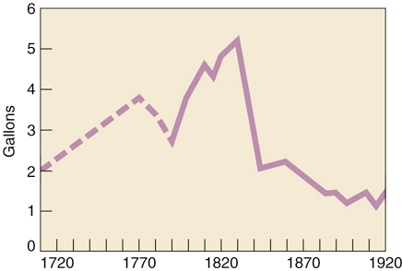
The Temperance Movement
During the next decade approximately 5000 local temperance societies were founded
As the movement gained momentum, annual per capita consumption of alcohol dropped sharply

Slide 11
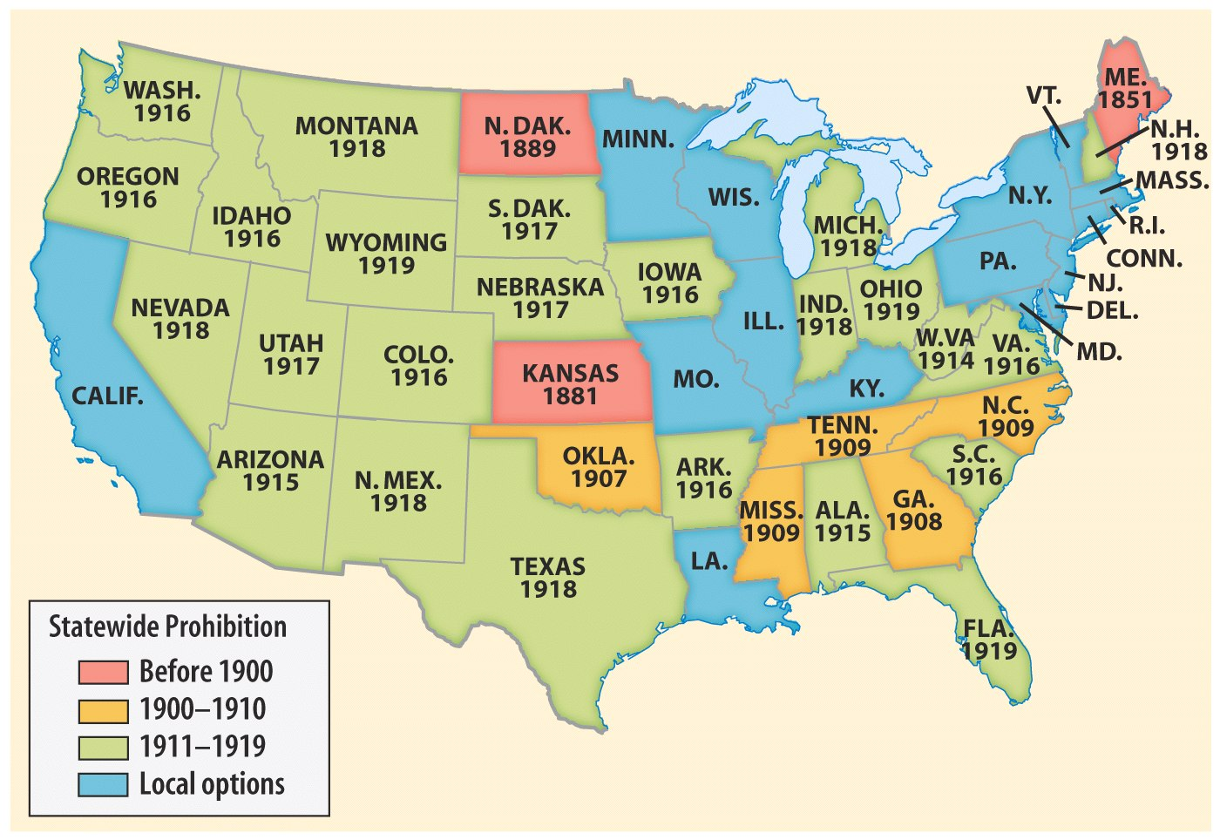
TEMPERANCE & PROHIBITION
Prohibition on the Eve of the 18th Amendment, 1919
Notes:
Henretta, America’s History 4e from http://www.bedfordstmartins.com/mapcentral

Slide 12
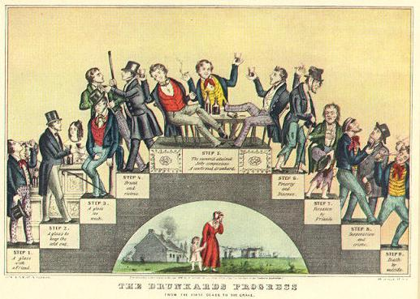
The Drunkard’s Progress
From the first glass to the grave, 1846

Slide 13
The Drunkard’s Progress
Step 1: A glass with a friend Step 2: A glass to keep the cold out Step 3: A glass too much
Step 4: Drunk and riotous Step 5: The summit attained: Jolly companions → a confirmed drunkard Step 6: Poverty and disease Step 7: Forsaken by friends Step 8: Desperation and crime Step 9: Death by suicide

